Slide 1
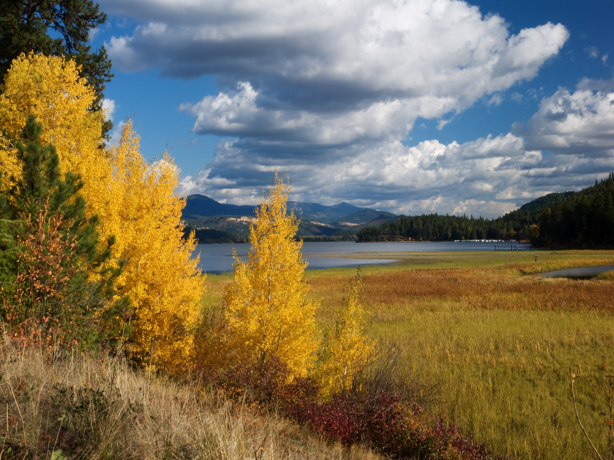
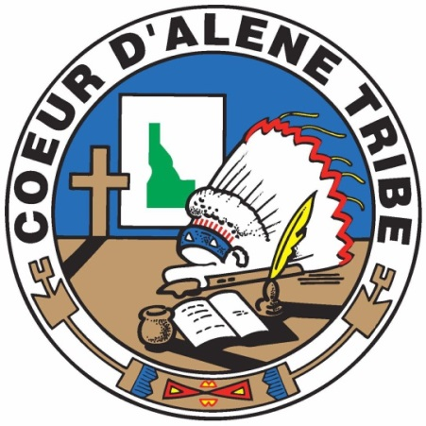
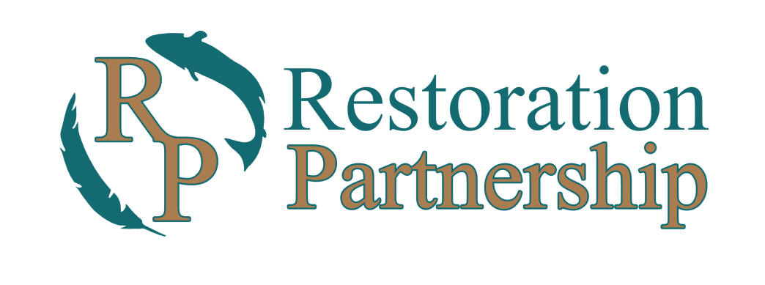
“Future Restoration Efforts
In the Coeur d’Alene Basin”
2017 ISPE conference 6-9-17
Notes:
Introduce yourself.

Slide 2

Overview
Restoration Partnership
History
NEPA/EIS/RP
Strategies and Techniques
Next Steps

Slide 3
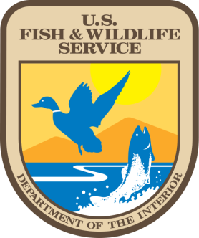
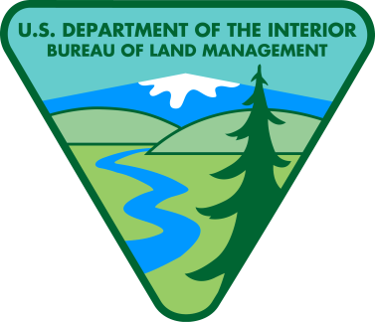
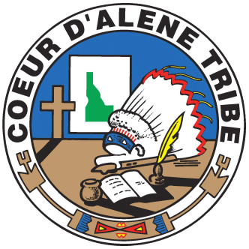
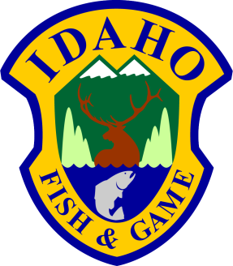
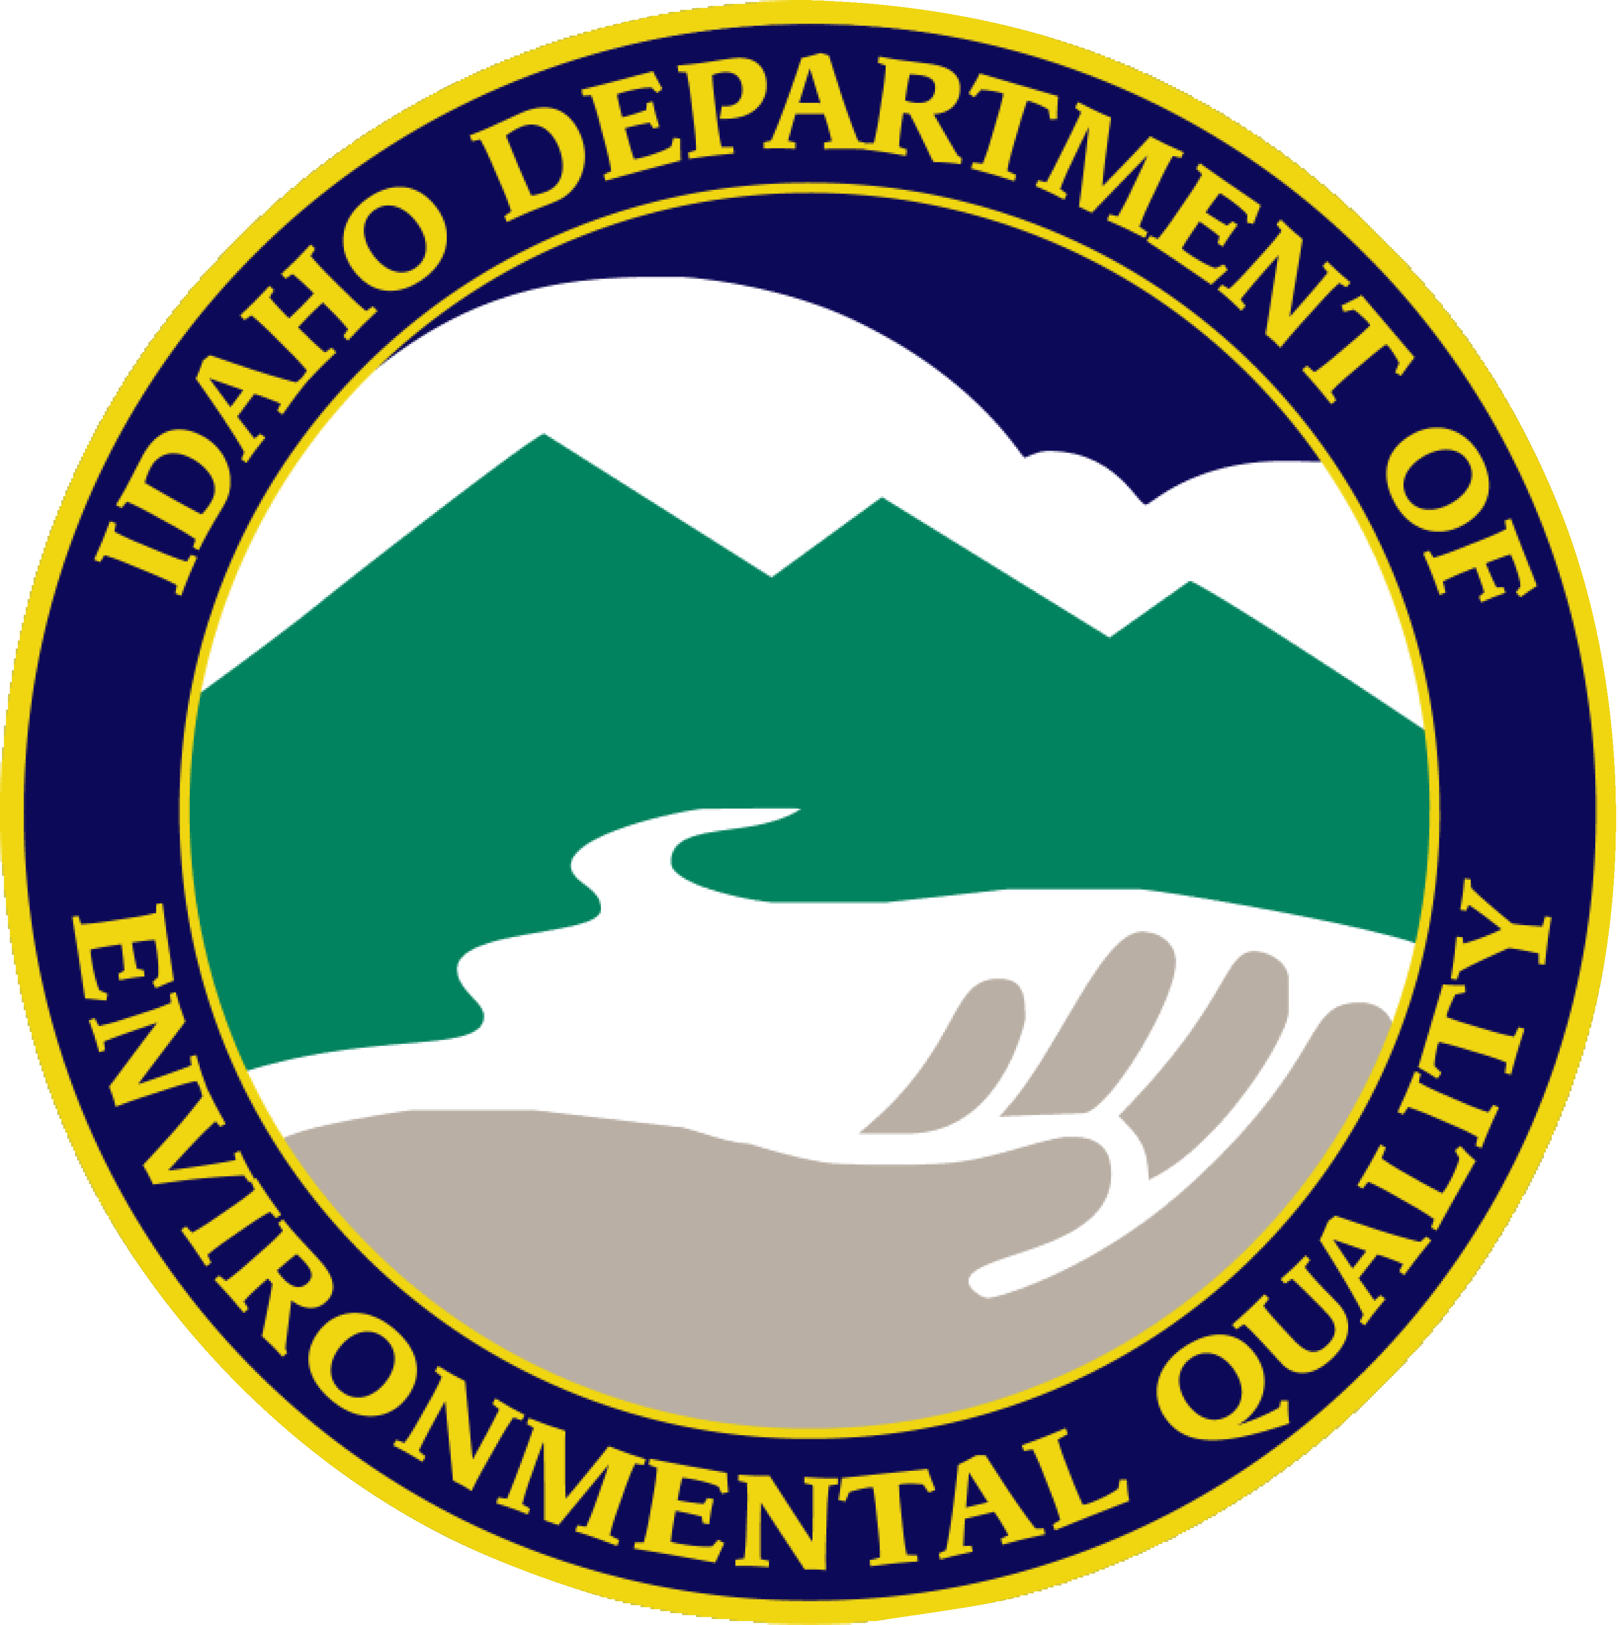
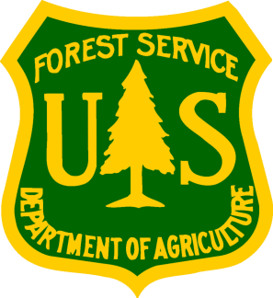
Restoration Partnership
Natural Resource Trustees / Trustee Council
U.S. Dept. of Interior U.S. Dept. of Agriculture
Coeur d’Alene Tribe State of Idaho
Representative Governments/Agencies
Notes:
The Coeur d’Alene Basin Natural Resource Trustees (Trustees) are the U.S. Department of Interior, U.S. Department of Agriculture, Coeur d’Alene Tribe and State of Idaho. Go through the flow chart and identify the agencies represented.
Over the years, there have been a number of MOA’s (~4). In the Coeur d’Alene Basin, the Trustees have chosen to work together through the Trustee Council which was developed through a 2012 Memorandum of Agreement.
The Comprehensive Environmental Response, Compensation and Liability Act (CERCLA) and Clean Water Act (CWA) identify Federal, Tribal and State governments as trustees over natural resources on behalf of the public. The role of the Trustees is to obtain monetary damages related to harm incurred to natural resources as a result of hazardous waste contamination. Then, the Trustees are to use those funds to engage in natural resources restoration.
The Trustees are now referred to as the Restoration Partnership.

Slide 4
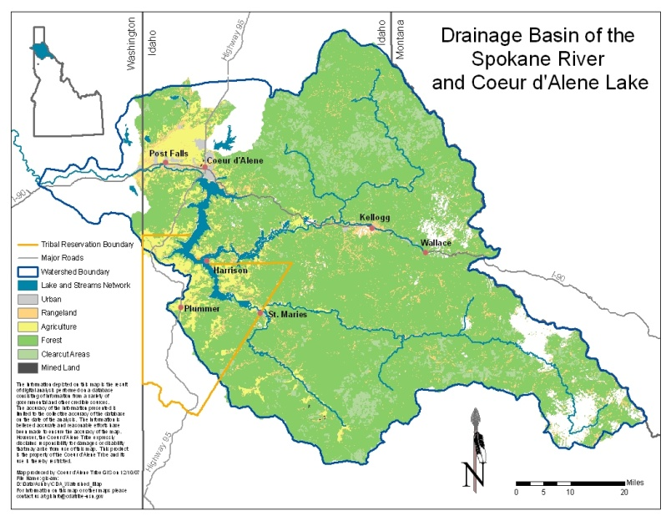
Notes:
The Cda Basin approximately 2.4 million acres

Slide 5
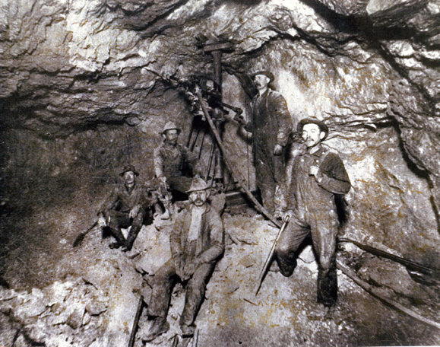
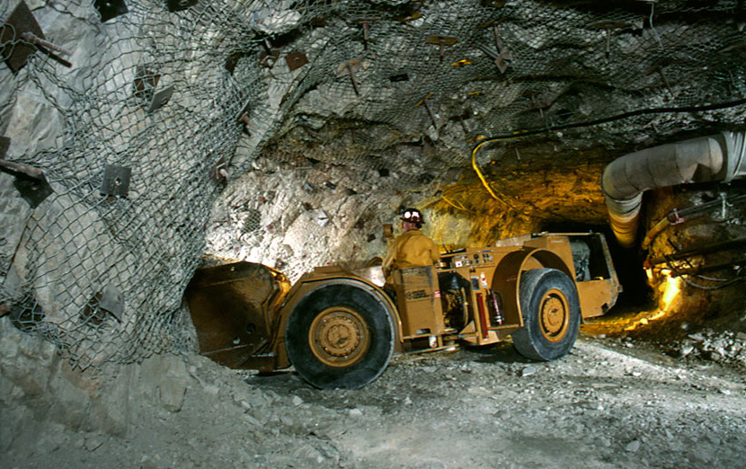
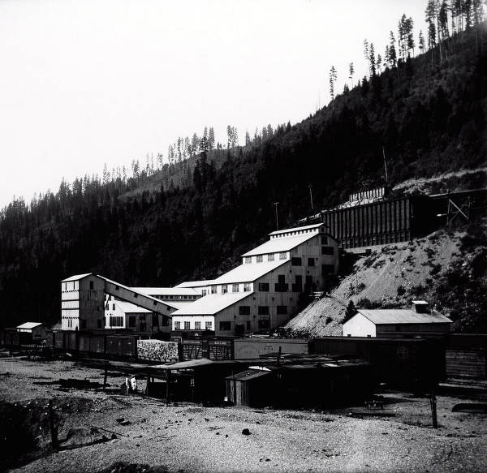
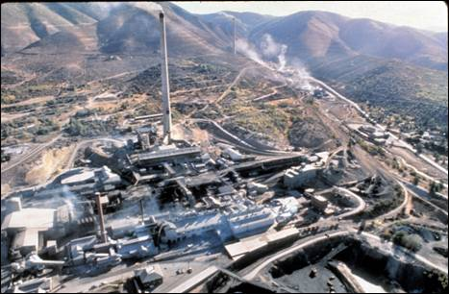
History
Notes:
In the late 1800s gold and silver were discovered in the Silver Valley and soon mining, logging, and community establishment began.
For more than 100 years, the Coeur d’Alene Mining District has been a leader in production of silver, lead, and zinc. Production from our area’s mines contributed to the economic development of the region as well as the war effort in WWI and WWII.
Mining is still a vital industry and metals produced from mining are needed for modern life. Products we rely on every day in our homes and businesses require some product of mining and it’s important that we recognize this.

Slide 6
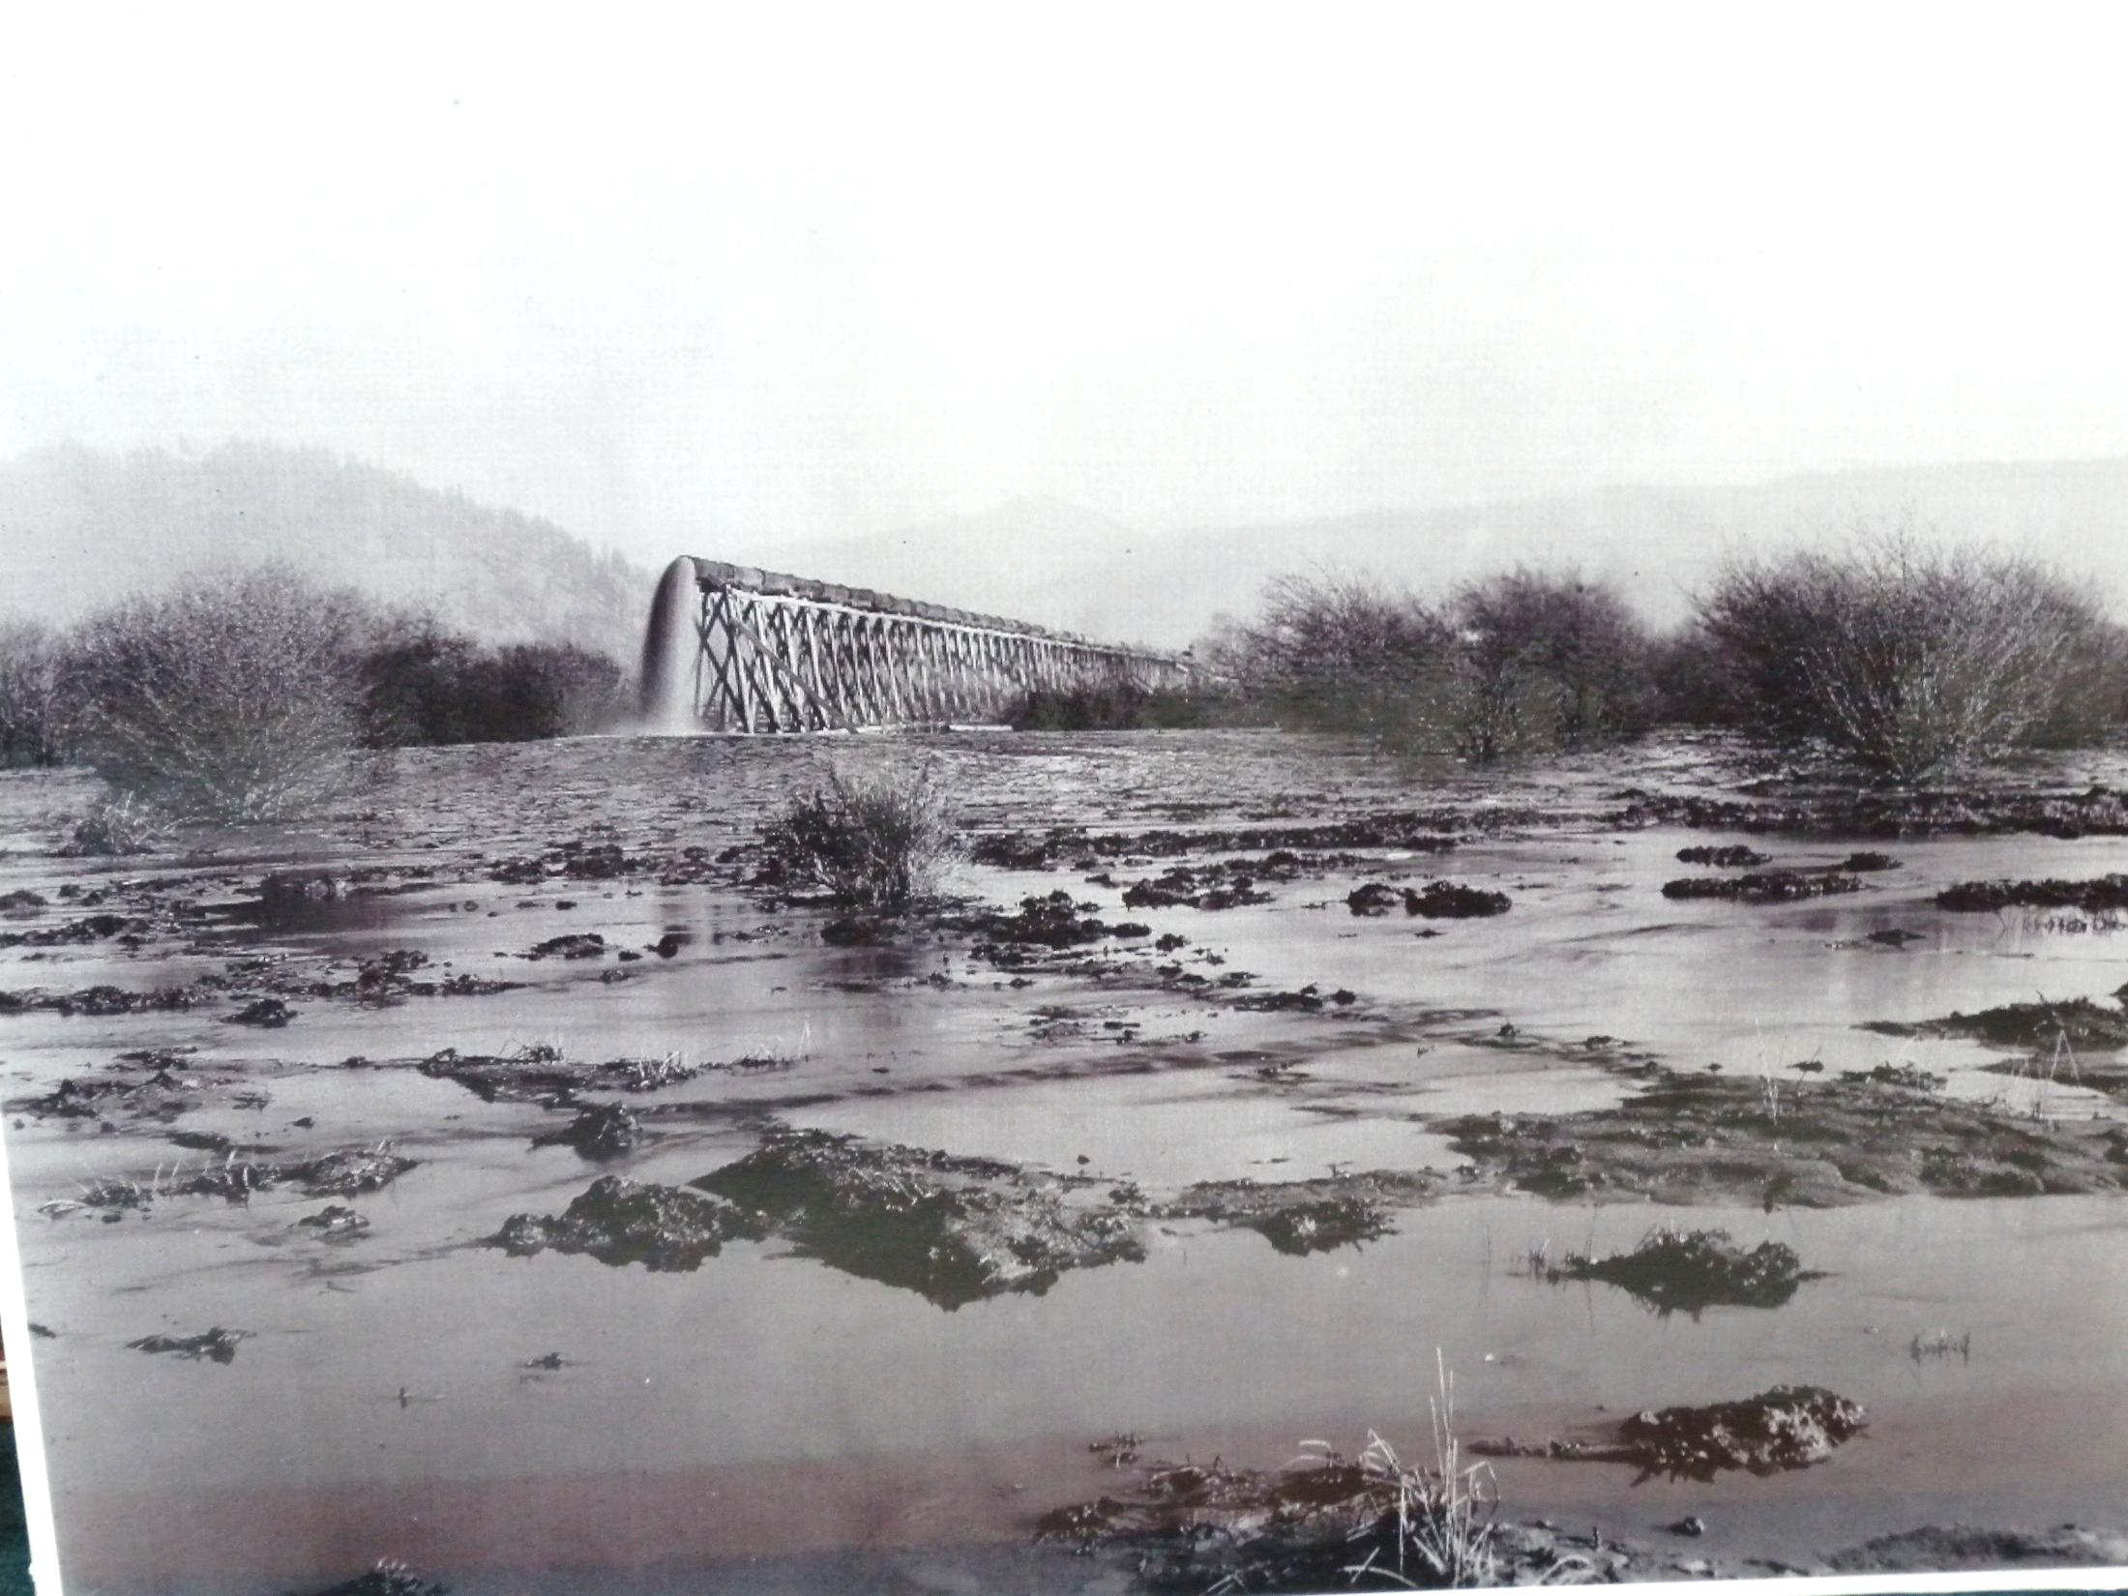
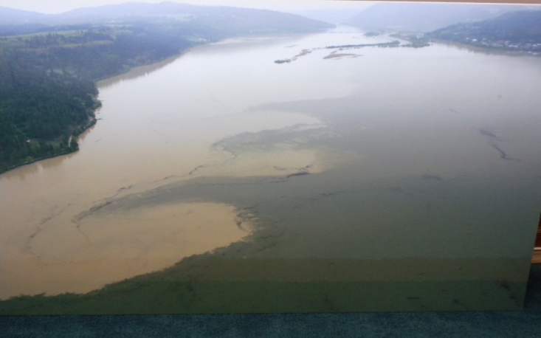
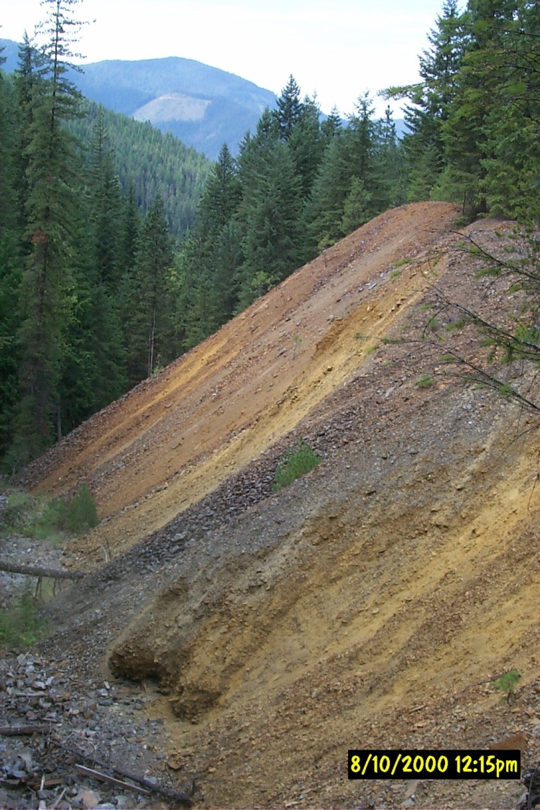
Notes:
Unfortunately due to some of the historic practices at mines, mills, and smelters, there were releases of wastes containing metals that spread throughout much of the Coeur d’Alene Basin. Some of those metals include but are not limited to: lead, zinc, arsenic, cadmium, copper, and others.
As a result, mining-related waste rock, tailings, mine drainage, and contaminated floodplain deposits are continuing sources of metals contamination in the Coeur d'Alene Basin. Surface and ground water continues to transport dissolved and particulate metals to downstream waters, soils, and floodplain sediments. Tailings and contaminated sediments continue to be deposited in the Coeur d’Alene River channel, levees, and floodplain, as well as in lakes and wetlands adjacent to the river, and in Coeur d’Alene Lake. These wastes resulted in natural resource injuries which we’ll describe in the next slide.
In 1983, the Bunker Hill Mining and Metallurgical Complex Site was listed on the National Priorities List as a Superfund Site and slated for remediation. The listing of the site by EPA as a Superfund site triggered the interest of the Natural Resource Trustees because natural resource injuries were not fully covered.
In 1985 the State of Idaho settled all NRD claims against the mining companies except Hecla. In 1991 the CDA Tribe initiated the NRDA and started collecting data. In the mid 90’s the Federal Trustees joined the Tribe and filed a series of lawsuits against companies considered potentially responsible. A series of settlement agreements followed from the mid-1980s until 2011. In 2012, the natural resource trustees combined to form the Restoration Partnership to jointly plan and implement restoration.
If asked: Approximately $136 million in settlement funds are available.

Slide 7
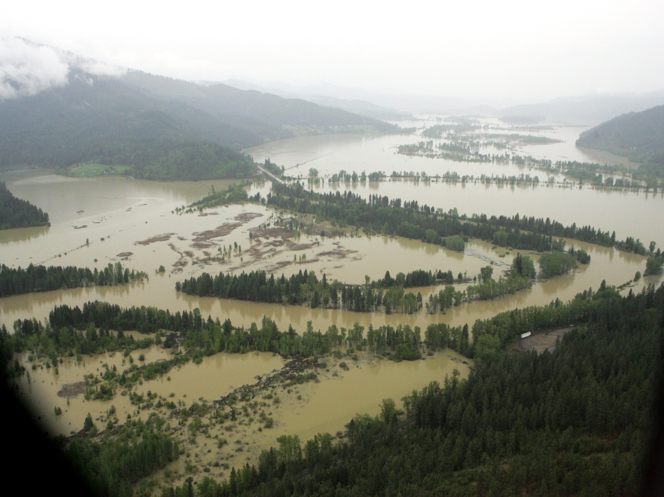
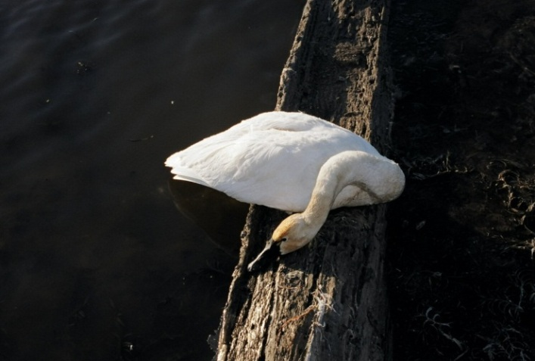
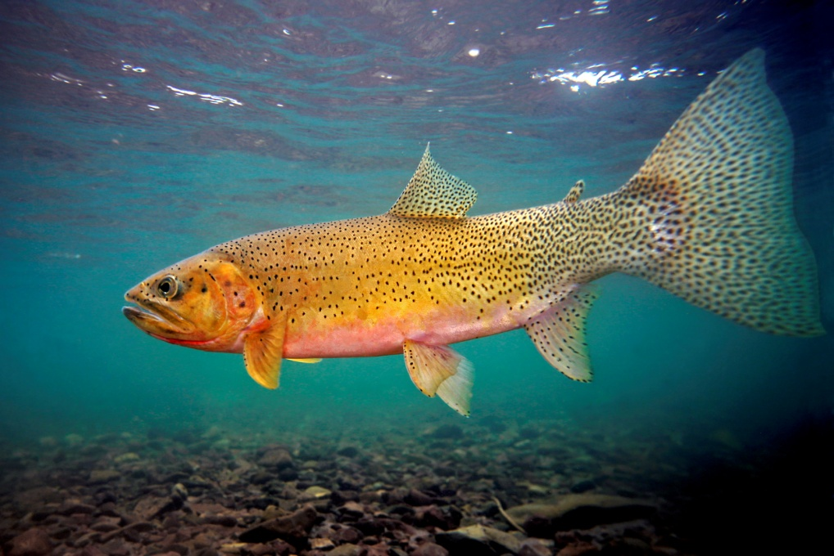
Water , Soils, and Sediment
Migratory Waterfowl
Fish and Aquatic Life
Photo courtesy of Pat Clayton
Notes:
What natural resources were found injured? After years of data collection and proving up injury to natural resources, the judge ruled in the Trustees favor and determined that the plaintiffs (i.e., Mining Companies) were found liable for damages (aka $$). The Trustees settled with all of the mining companies except for the ‘last man standing’ Hecla not until 2011. Since that last settlement, the Trustees have been working on a restoration plan.
The natural resource injuries that were documented (and later acknowledged in District Court) included: surface water, groundwater riparian resources, benthic macroinvertebrates and phytoplankton, fish, birds (in particular, migratory waterfowl), soils and sediments.
An extensive Injury Assessment was completed over the course of 5-6 years that included intensive data collection to document injuries to natural resources. Examples of injuries include sickness, reduced ability to thrive and reproduce, and even death for fish and wildlife. The quality of surface water and ground water was impaired. The metals content of some soils made it difficult to grow vegetation.
Ex: if inquired: Waterfowl deaths in the Coeur d’Alene Basin have been reported since 1924 and bird carcasses collected from the basin consistently have shown evidence of Pb exposure and lesions indicative of Pb poisoning. Dead swan numbers have fluctuated over the years due to changes in weather (how long they stay in the basin) and migratory patterns. To give you an idea of some data that was collected and used in the injury assessment in the 80’s, 200/1200 tundra swans died in the basin due to Pb poisoning (based on emaciation, engorged gall bladder, impacted gizzard, gastrointestinal problems, and Pb in the tissue. (Krieger, 1990)

Slide 8
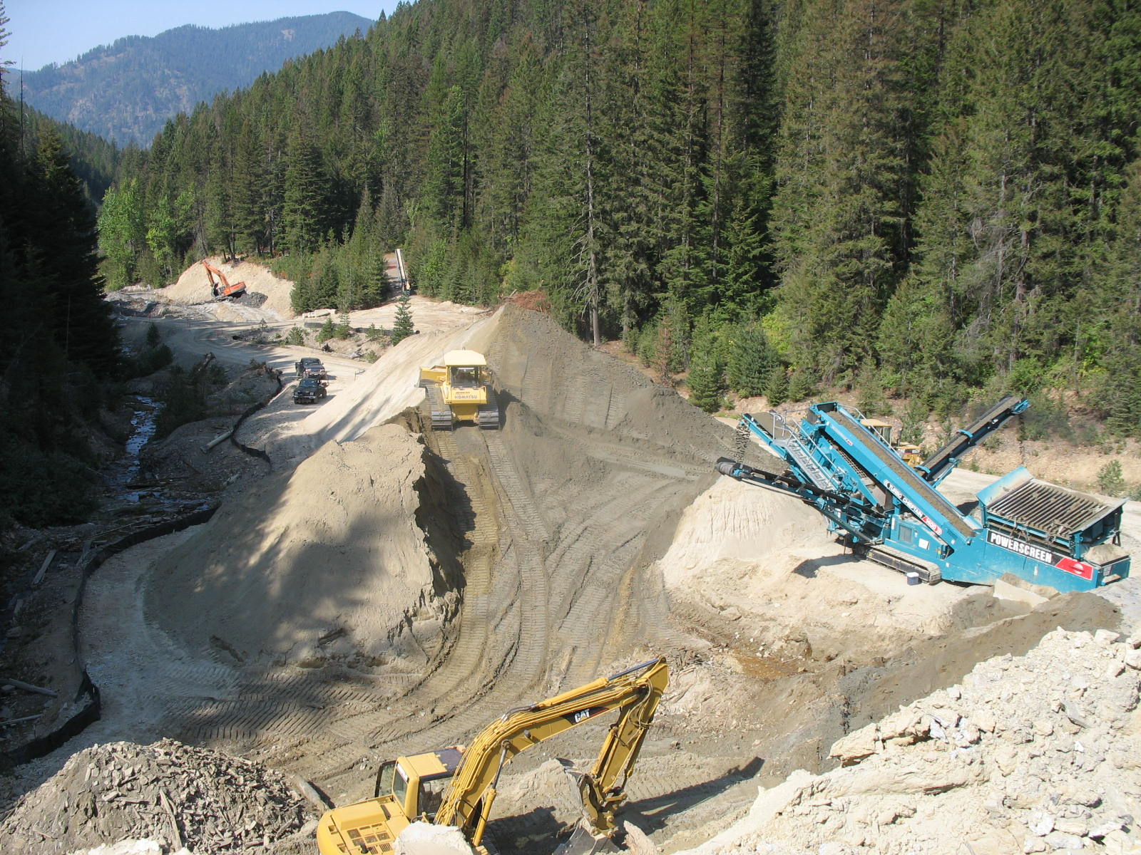
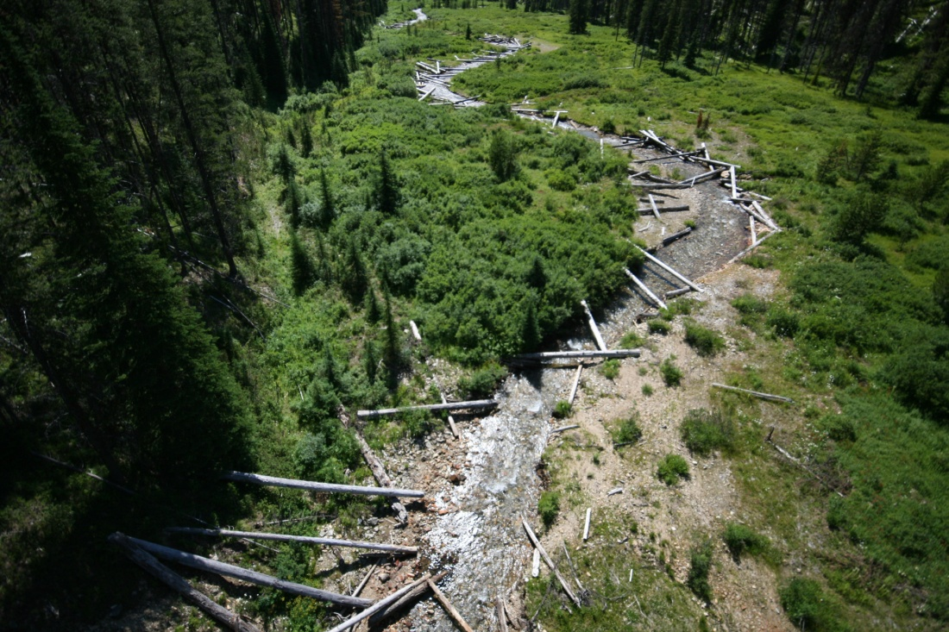
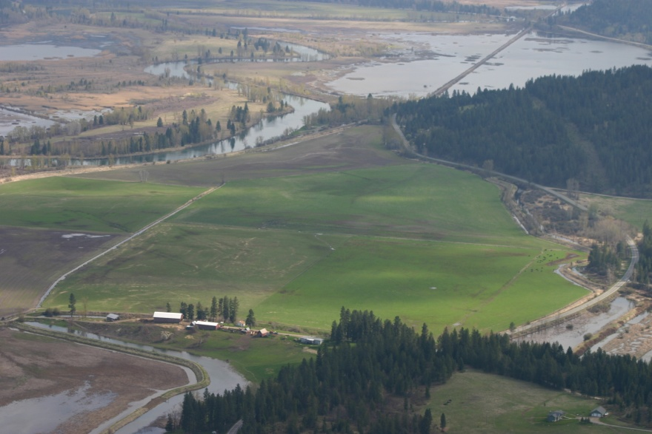
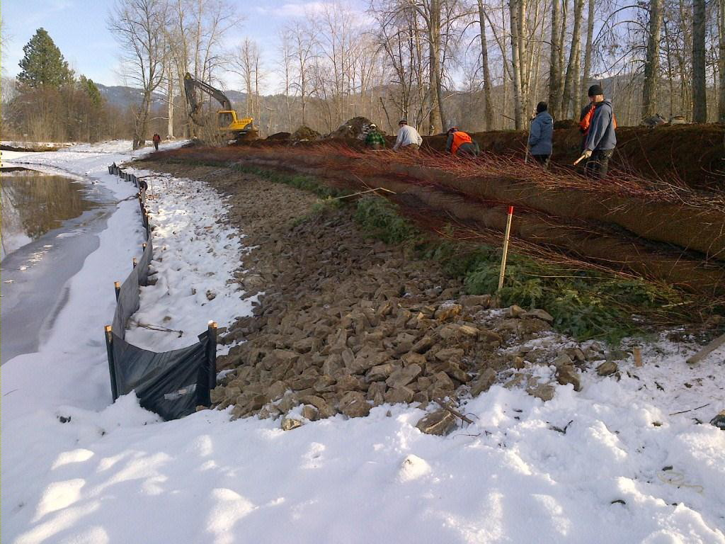
Restoration compares to Remediation
Notes:
The difference between remediation and restoration: CERCLA; NRDA and Superfund together.
Remediation, also known in the Basin as the “Superfund Cleanup” or the “Coeur d’Alene Basin Cleanup,” is the process of addressing mine-waste contamination in order to protect human health and the environment. The EPA is responsible for leading remediation and working with the Idaho Department of Environmental Quality and basin stakeholders.
Restoration is the process of returning natural resources back to a healthy condition. The Natural Resource Trustees, through the Restoration Partnership and in partnership with the public, are in charge of natural resource restoration.
Oftentimes, in order for restoration projects to take place, remediation must happen first. In these cases, coordination must take place between those working on restoration and those working on remediation.
Primary vs. Compensatory Restoration. We will be integrating our restoration with EPA’s remedy so it is imperative that we continue to coordinate our efforts with their efforts early on so our restoration techniques are considered & or included in EPA’s design documents.
Notes:
Restoration, simply put, means to return a natural resource back to a healthy condition. Building wetlands, riverbanks, and fish habitat, planting trees and vegetation, and increasing water quality are some of the ways we can work to restore our natural resources. For any given restoration project, we can focus on resources that have been harmed by mine-waste contamination or we can replace them by developing or protecting the same types of resources in a different location. An example of the latter is if a wetland has been too heavily impacted by lead contamination, and we cannot prevent future contamination from happening, we might then decide that it is better to develop a wetland in a different location. By doing restoration projects we will enrich the natural beauty we already see in the Coeur d’Alene Basin area. Experiencing the abundance this land offers with our family and friends: it’s why we live here!!!
Be careful as these may seem pre-decisional. Some types of restoration may include but are not limited to: riverbank stabilization, stream restoration, wetland rehabilitation, reforestation, etc.

Slide 9
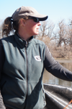
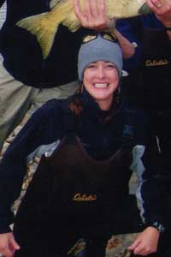


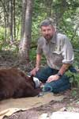

From Settlement to Planning
In 2012
Notes:
In 2009 Hecla negotiations began and settlement was likely on the horizon. The Trustees started the conversation whether to contract out the Restoration Plan development or to take it on among themselves. They got a bid from one of their expert witnesses to do the NEPA and write the restoration plan however, due to strong legal advice from the DOI Solicitor saying that we would have to do NEPA, some of the Trustees pushed to form a technical team within their own Trustees to write the plan and PEIS in house. This was prior to knowing that we would be venturing into the world of NEPA.
1- Tribe: (Coordinator, Lake, and Cultural Resources)
2- State of Idaho: (Water Quality and Wetlands Specialist)
2- Feds: (NEPA, Engineering, Fisheries, & Wildlife)
1- RP: 1 neutral. (Communications Specialist)
Revised the MOA, developed Policies & Procedures, Restoration Team Charter, started a Financial Charter, Originally had 2 Co-Coordinators.

Slide 10

The Public shapes the Plan
Keep projects in the CDA Basin
Focus on water quality and fish
Maintain public access
Do projects with partners
Specific projects and strategies were mentioned
Notes:
Scoping started in June 2013 by posting an NOI on the Federal Register for 60 days and then extended to 75 days.
The purpose of scoping is to solicit input on the issues and impacts that will be addressed in a NEPA document as well as determine the degree to which those issues and impacts will be analyzed. The intent is to focus the analysis on significant issues and reasonable alternatives, to eliminate extraneous discussion, and to reduce the length of the EIS. Scoping also allows the Partnership to collect information about what is important to the public. This information (e.g., priority resources, geographic areas, etc.) will inform the Partnership as it develops the restoration you can see the Scoping report online but to summarize, ~226 comments from just over 100 people. Most used the website.

Slide 11
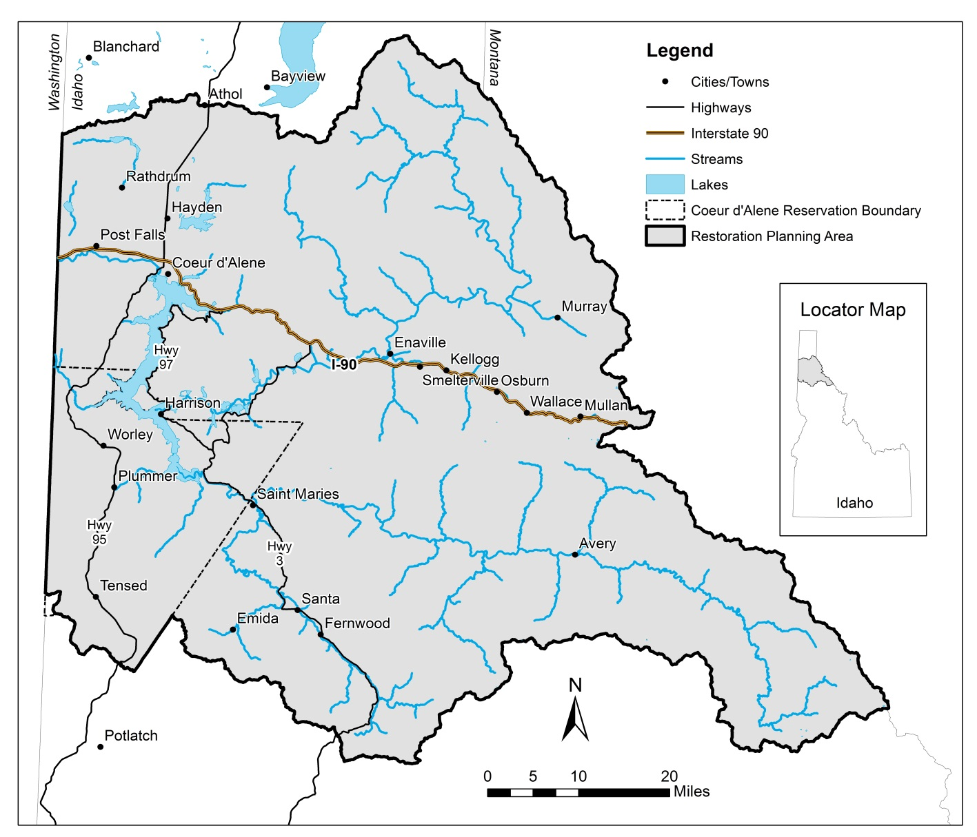
Restoration Planning Area
Notes:
Currently, our planning area focuses on the Coeur d’Alene Basin. The drainage area covers approximately 2.4 million acres and includes 5 subbasins. They are the Upper Coeur d’Alene River (North Fork), South Fork Coeur d’Alene River, St. Joe River Subbasin, Coeur d’Alene Lake, and Upper Spokane Subbasin within the State of Idaho.
Our Basin boundaries include all five of the watersheds that drain into Coeur d’Alene Lake and the Upper Spokane River.
Point out the Upper Hangman Creek watershed within the reservation boundary that is not in the CDA Basin HUC so not hydrologically connected. **Remember this for later in the presentation.
If asked: This includes both EPA’s project area (based off of where contaminants have come to be located) as well as uncontaminated headwaters and tributaries.

Slide 12
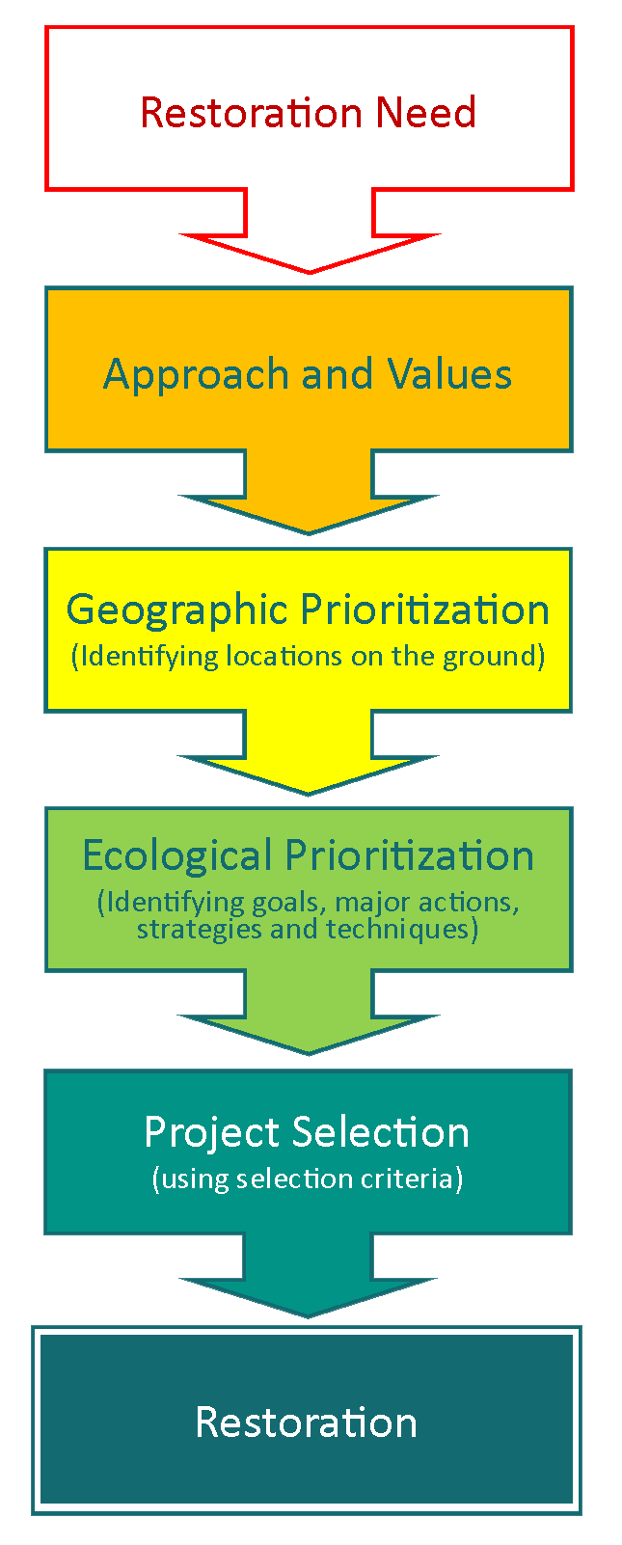
Programmatic
Draft plan does not include specific projects or sites
Framework of approaches and priorities
Solicitation and selection of projects

Slide 13
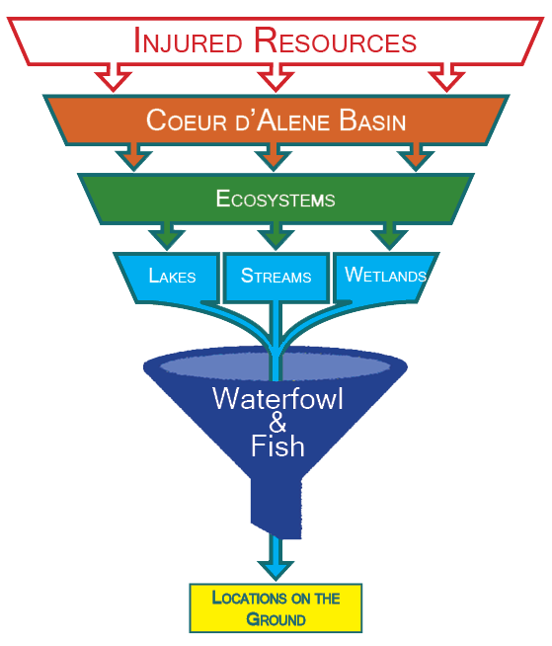
Geographic Prioritization
Notes:
Identify Goals of habitat restoration and the goals determine the methods.

Slide 14
Wetlands
Geographic priorities guided by needs of waterfowl (bird use and degree of contamination)
Notes:
The Restoration Partnership is going through a specific planning process in order to accomplish restoration projects. This planning process is required by the National Environmental Policy Act (NEPA) and is designed to make sure the public is involved. Since we are excited to have you help shape the plan, the Restoration Partnership is always accepting comments and ideas.
Public Scoping
The First period of time will be a 60-day period beginning in June 2013 and ending mid to late August 2013. This period of time is referred to as “scoping” and its purpose is to gain ideas from you regarding the adoption of a restoration plan for the Coeur d’Alene Basin. You can submit any type of comment or information you desire regarding this. The Restoration Partnership will use this information to determine how to move forward on a restoration plan. Your ideas and values will help shape the draft version of the Restoration Plan. Using this website or attending public open-house meetings are ways that you can provide input during this time.

Slide 15
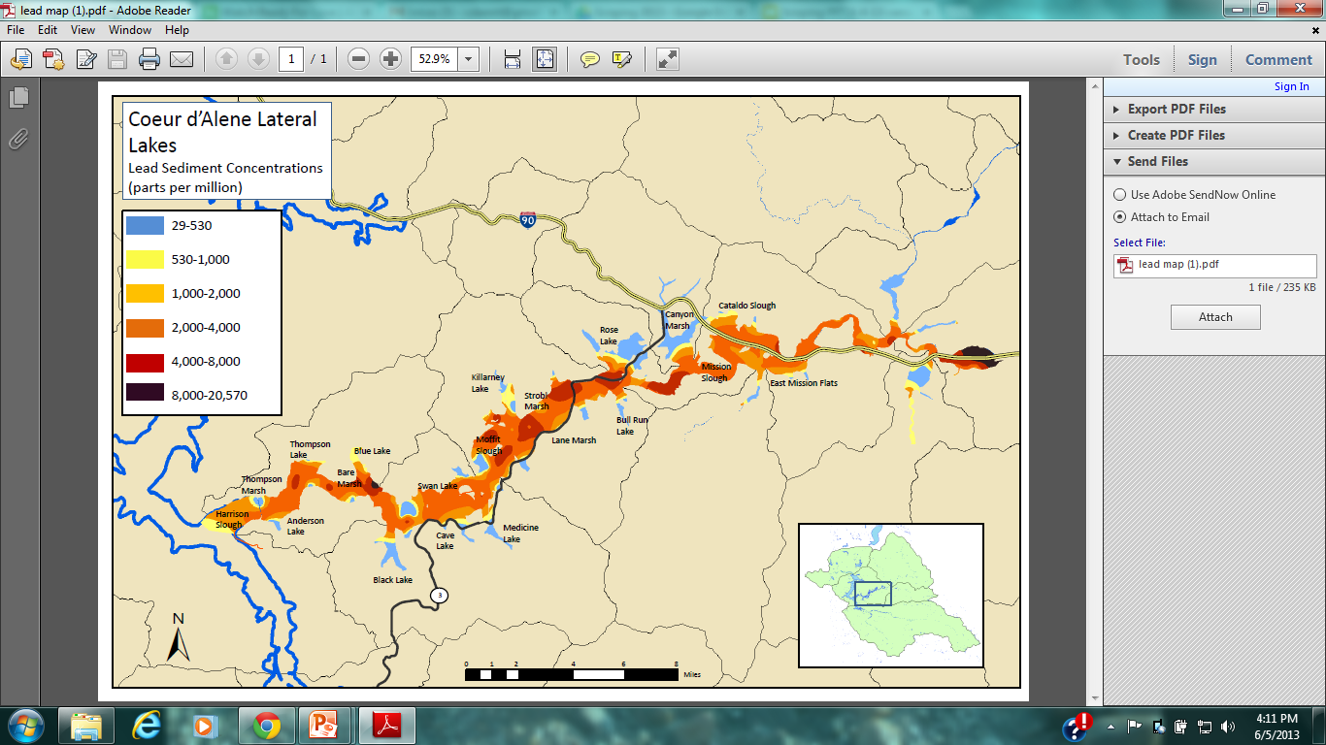
Tier 1 wetlands- based on
Birds/year and metals

Slide 16
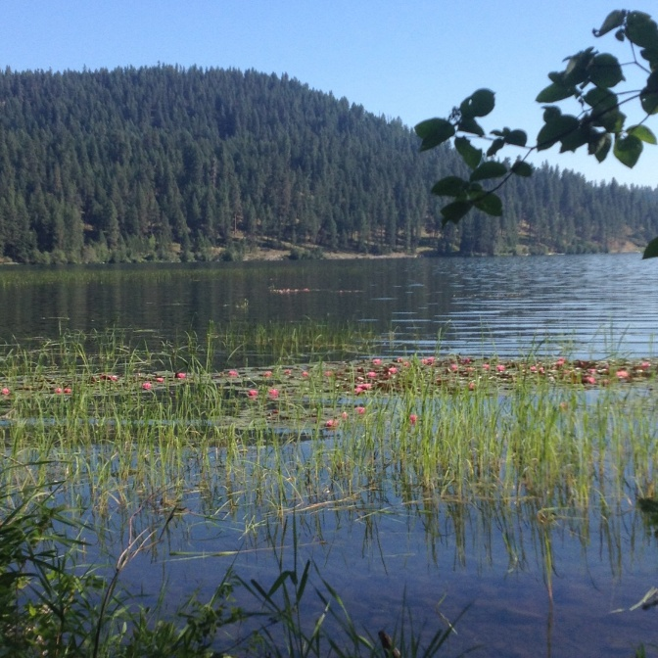
Strategies for Wetlands
Restore Hydrology
Water manipulation
Soil mgt.
Topo manipulation
Reconnection
Protection
Coordinate with clean up

Slide 17
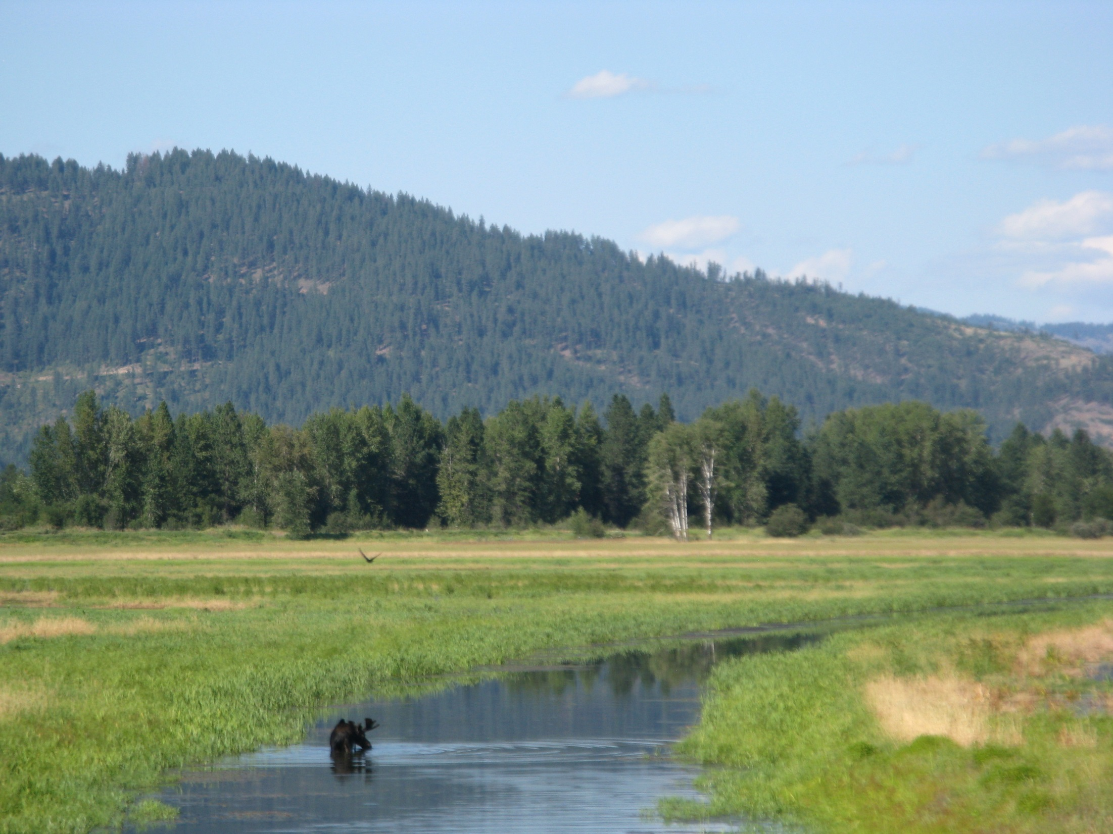
Techniques for Wetlands
Diking
Water control structures
Pump water
Shallow water excavation
Plug ditches
Plant desirable veg
Control noxious weeds
Blasting
Island construction
Breach levees
Easements
Cap & flip soils

Slide 18
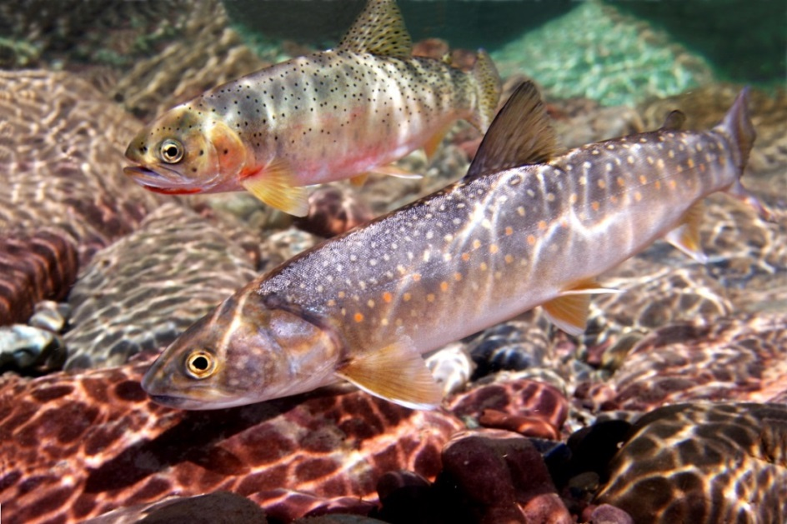
Streams
Geographic priorities guided by needs of native trout (westslope cutthroat trout and bull trout)
Notes:
The Restoration Partnership is going through a specific planning process in order to accomplish restoration projects. This planning process is required by the National Environmental Policy Act (NEPA) and is designed to make sure the public is involved. Since we are excited to have you help shape the plan, the Restoration Partnership is always accepting comments and ideas.
Public Scoping
The First period of time will be a 60-day period beginning in June 2013 and ending mid to late August 2013. This period of time is referred to as “scoping” and its purpose is to gain ideas from you regarding the adoption of a restoration plan for the Coeur d’Alene Basin. You can submit any type of comment or information you desire regarding this. The Restoration Partnership will use this information to determine how to move forward on a restoration plan. Your ideas and values will help shape the draft version of the Restoration Plan. Using this website or attending public open-house meetings are ways that you can provide input during this time.

Slide 19
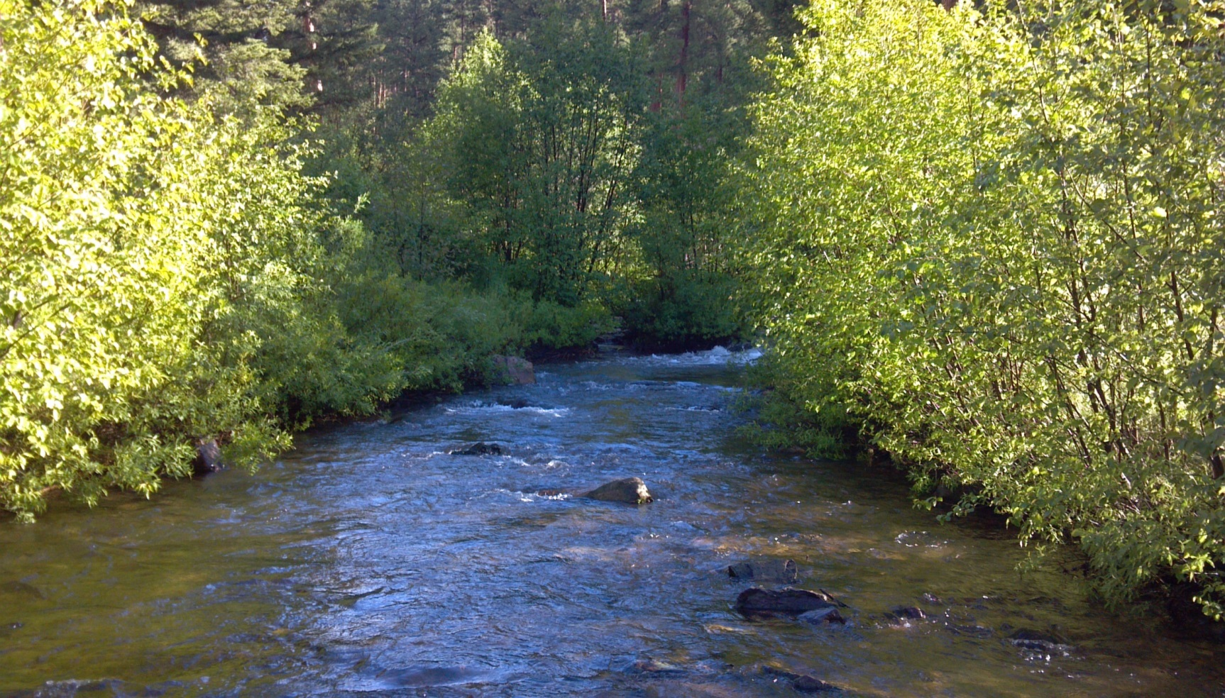
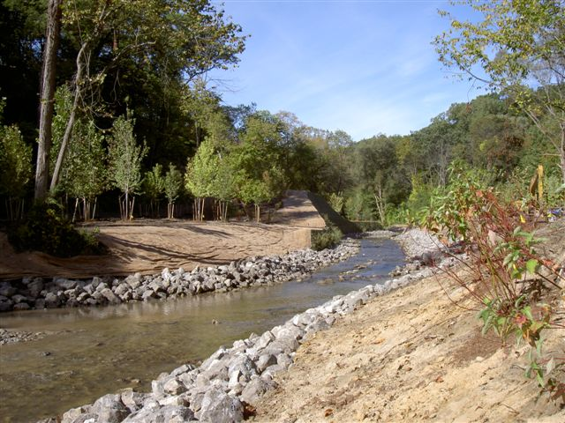
Strategies for Streams
Protection
Passive Restoration
Restore in stream structure
Restore riparian
Channel Geometry & Sinuosity
Resilience to erosion
Connectivity

Slide 20
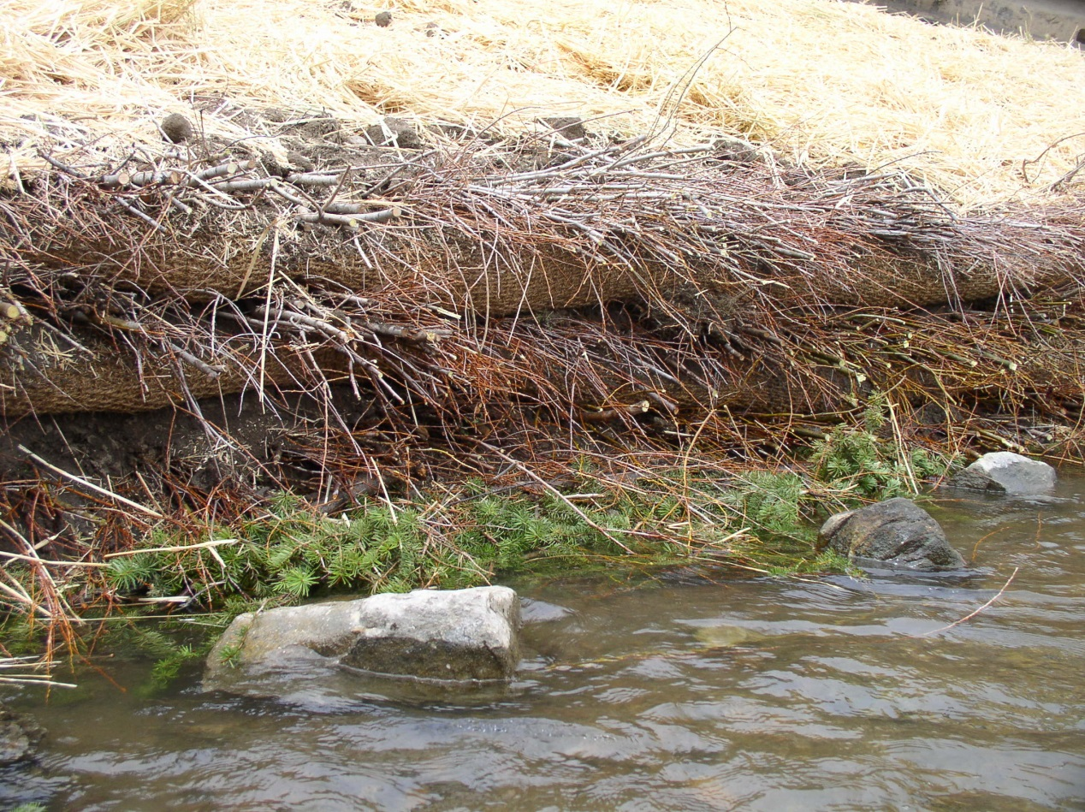
Techniques for Streams
Fencing & traffic control
Acquisition
Eliminate env. Stressors
Woody debris jams
Bioengineering
Native plants
Snag creation
Channel reconstruction
Install roughness, woody debris, facines, etc.
Provide fish passage
Replace culverts with open-bottom structures
Notes:
Vegetation is the answer but can be difficult to make it work. Timing is key! Major challenges: ice jams, anchor ice, break-up, rain-on-snow
Short growing season
Banks and beds comprised of easily erodible glacial till
Incredible recreation pressure
Why start at the toe? Prevent undermining from bottom
Moderate shear stress
Trap sediment=>
builds banks and bed

Slide 21
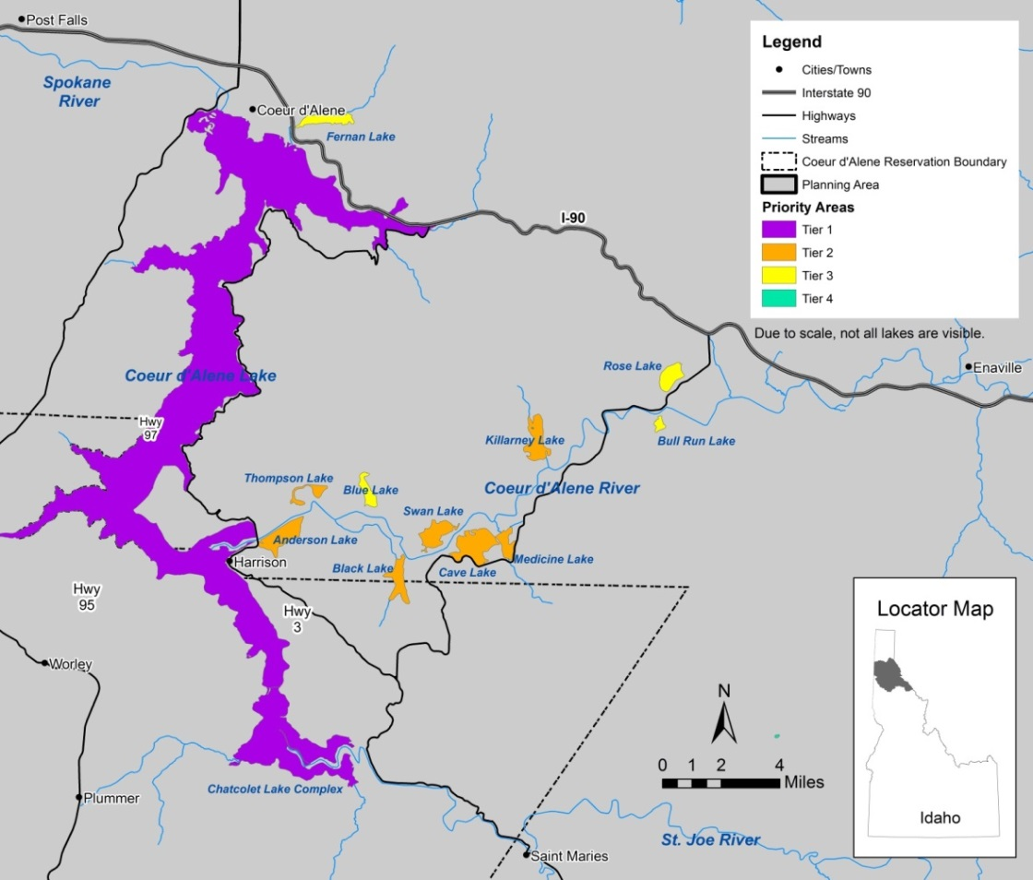
Lakes
Geographic priorities guided by needs of waterfowl and native trout
Coeur d’Alene Lake complex top priority
Notes:
The Restoration Partnership is going through a specific planning process in order to accomplish restoration projects. This planning process is required by the National Environmental Policy Act (NEPA) and is designed to make sure the public is involved. Since we are excited to have you help shape the plan, the Restoration Partnership is always accepting comments and ideas.
Public Scoping
The First period of time will be a 60-day period beginning in June 2013 and ending mid to late August 2013. This period of time is referred to as “scoping” and its purpose is to gain ideas from you regarding the adoption of a restoration plan for the Coeur d’Alene Basin. You can submit any type of comment or information you desire regarding this. The Restoration Partnership will use this information to determine how to move forward on a restoration plan. Your ideas and values will help shape the draft version of the Restoration Plan. Using this website or attending public open-house meetings are ways that you can provide input during this time.

Slide 22
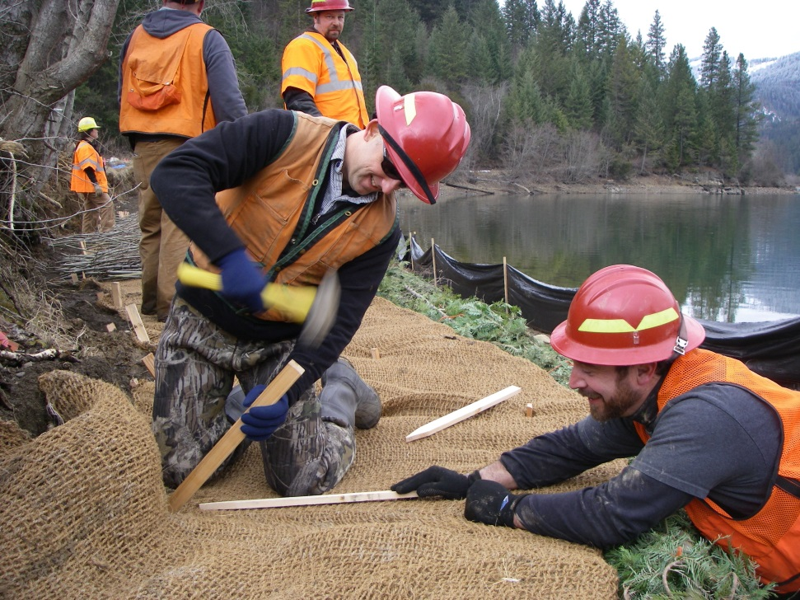
Strategies for Lakes
Refine predictive tools
Nutrient source inventories
Increase knowledge of food web dynamics
Public awareness
Restore shoreline veg
Protect shorelines
Survey, prevent, & control invasive species
Use native fish inventories to prioritize
Notes:
Roughness is important everywhere..all the time. Holds banks together and provides habitat.
Facines: Easy to make and install
Readily available biomass
Make very good use of volunteers
Outstanding longevity, retention, and ecological value

Slide 23
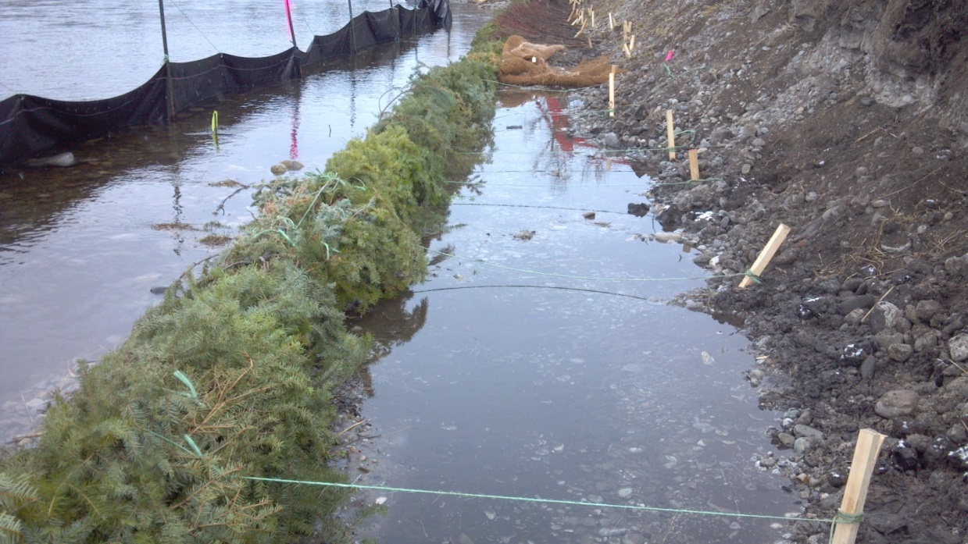
Techniques for Lakes
Collect data
Support the LMP
Support outreach efforts (e.g., Our Gem)
Use Streams and Wetlands
Shoreline native veg
Manage non-native fish pops
Reshape banks
Remove adjacent roads, fencing
Reduce spread of noxious weeds

Slide 24
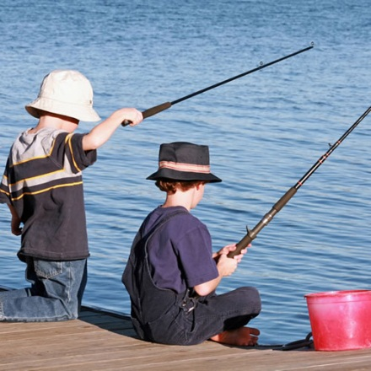
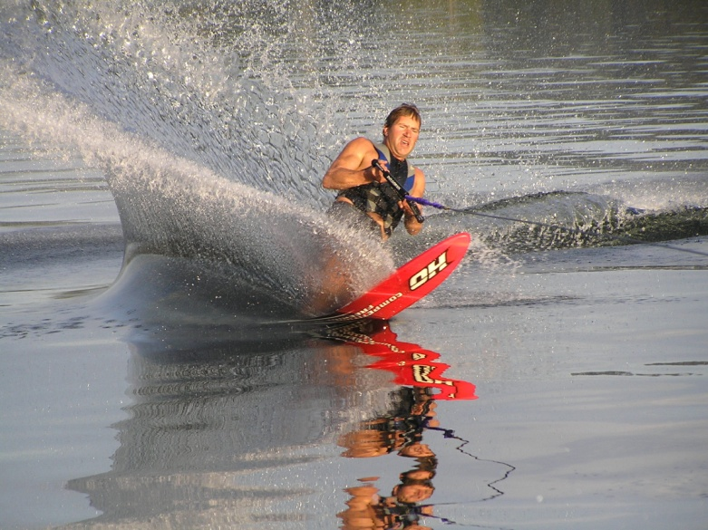
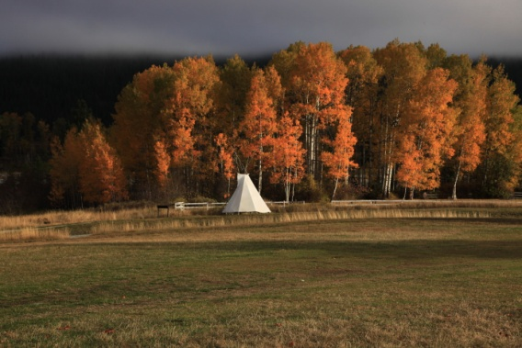

Human Uses
Notes:
This became a really challenging point in time where the Tribe requested that Hangman Creek Watershed within the reservation boundaries be included due to the close proximity to major Tribal population centers, moratorium on gathering subsistence foods, or practicing traditional ceremonial practices in the aboriginal territory. The other Trustees (a lot of which were new with little NRDA background) did and still not understand the compensatory nature of NRDA in that work in the un-contaminated portions of Hangman Creek that were not directly injured by mine waste, would be both replacement and compensatory in nature.

Slide 25
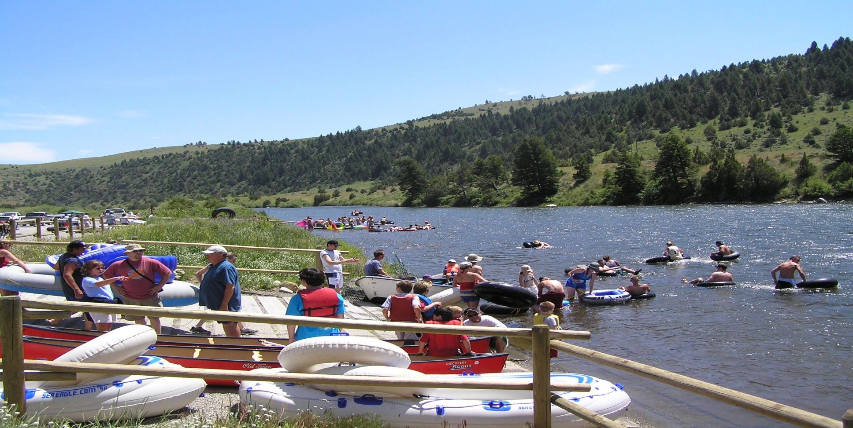
Strategies for Human Uses
Improve recreation & infrastructure sites
Improve scenery
Support NR Education ops
Restore and connect to cultural resources
Preserve open spaces

Slide 26
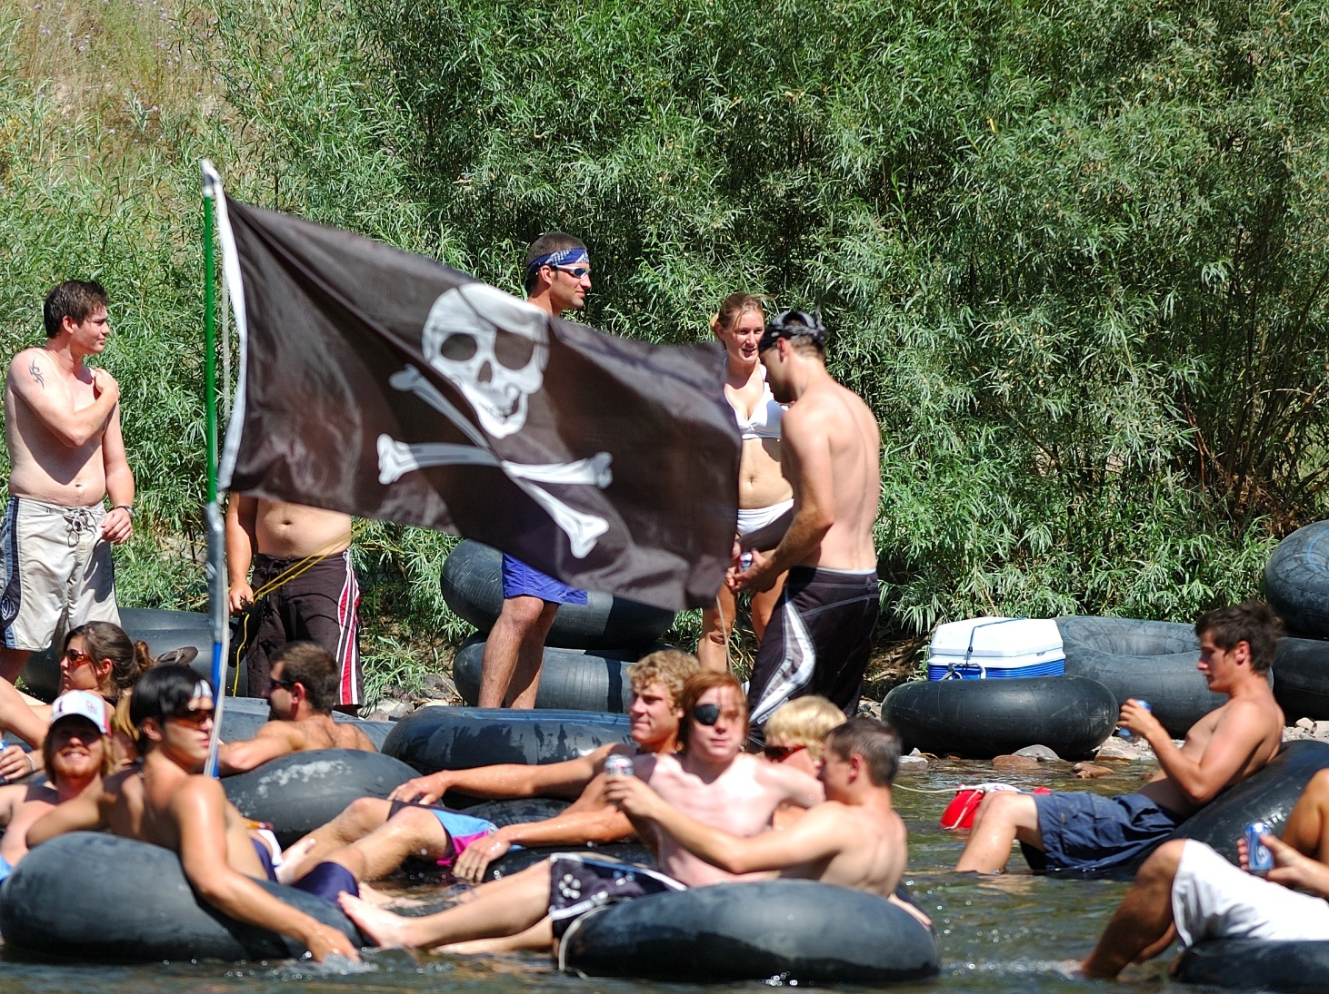

Techniques for Human Uses
Construct/improve access
Partner with land managers
Veg plantings to deter
“Leave no Trace”
Observation blinds
Demonstration projects
Outdoor classrooms
Work with Tribal elders
Provide for subsistence opportunities
Interpretive trails
Boardwalks
Viewing areas
Dude, we can’t hang out on the bank any more and drink beer
Yeah, those willows are totally BOGUS

Slide 27
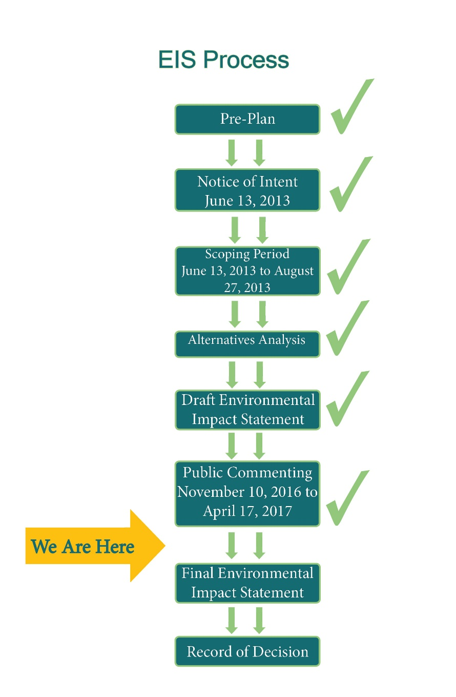
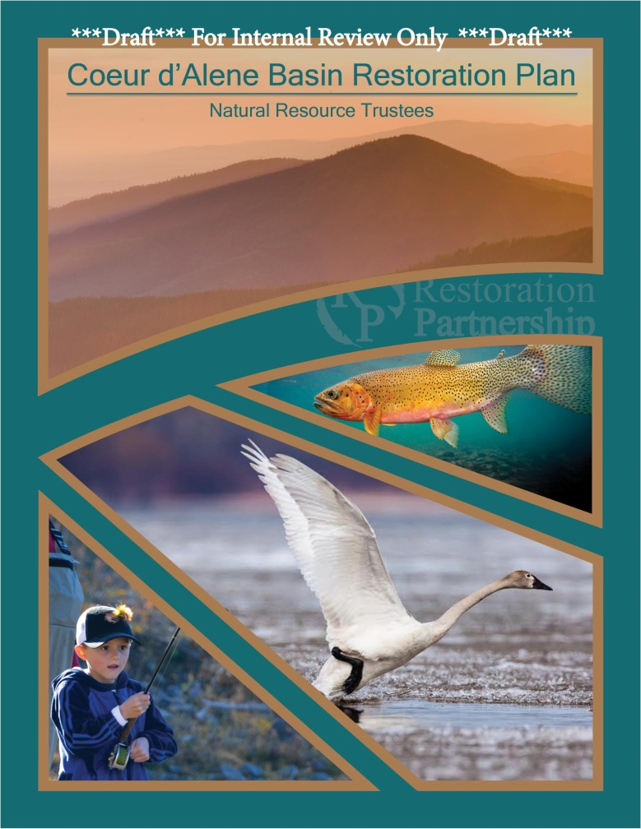
Looking forward
Notes:
All of this depends on timing and how long it takes to respond to comments.
Then lastly…implement restoration of course!!

Slide 28
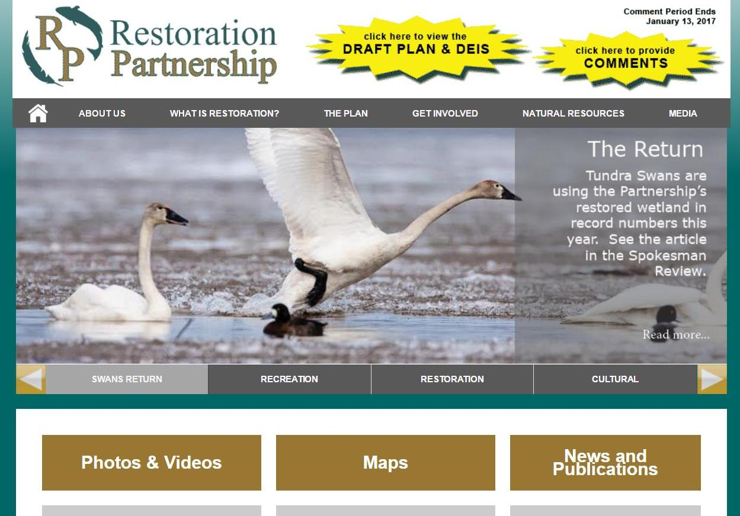
www.restorationpartnership.org
Notes:
Use a website for engaging with the public. We had a Communications Specialist that worked with the Federal and State Trustees Public Affairs staff and that worked well. Unfortunately, it was a bit difficult for him to stay neutral (Tribal member) so it kind of burned him out. Once the ROD is issued, all public relations will be handled internally by the Trustees.

Slide 29
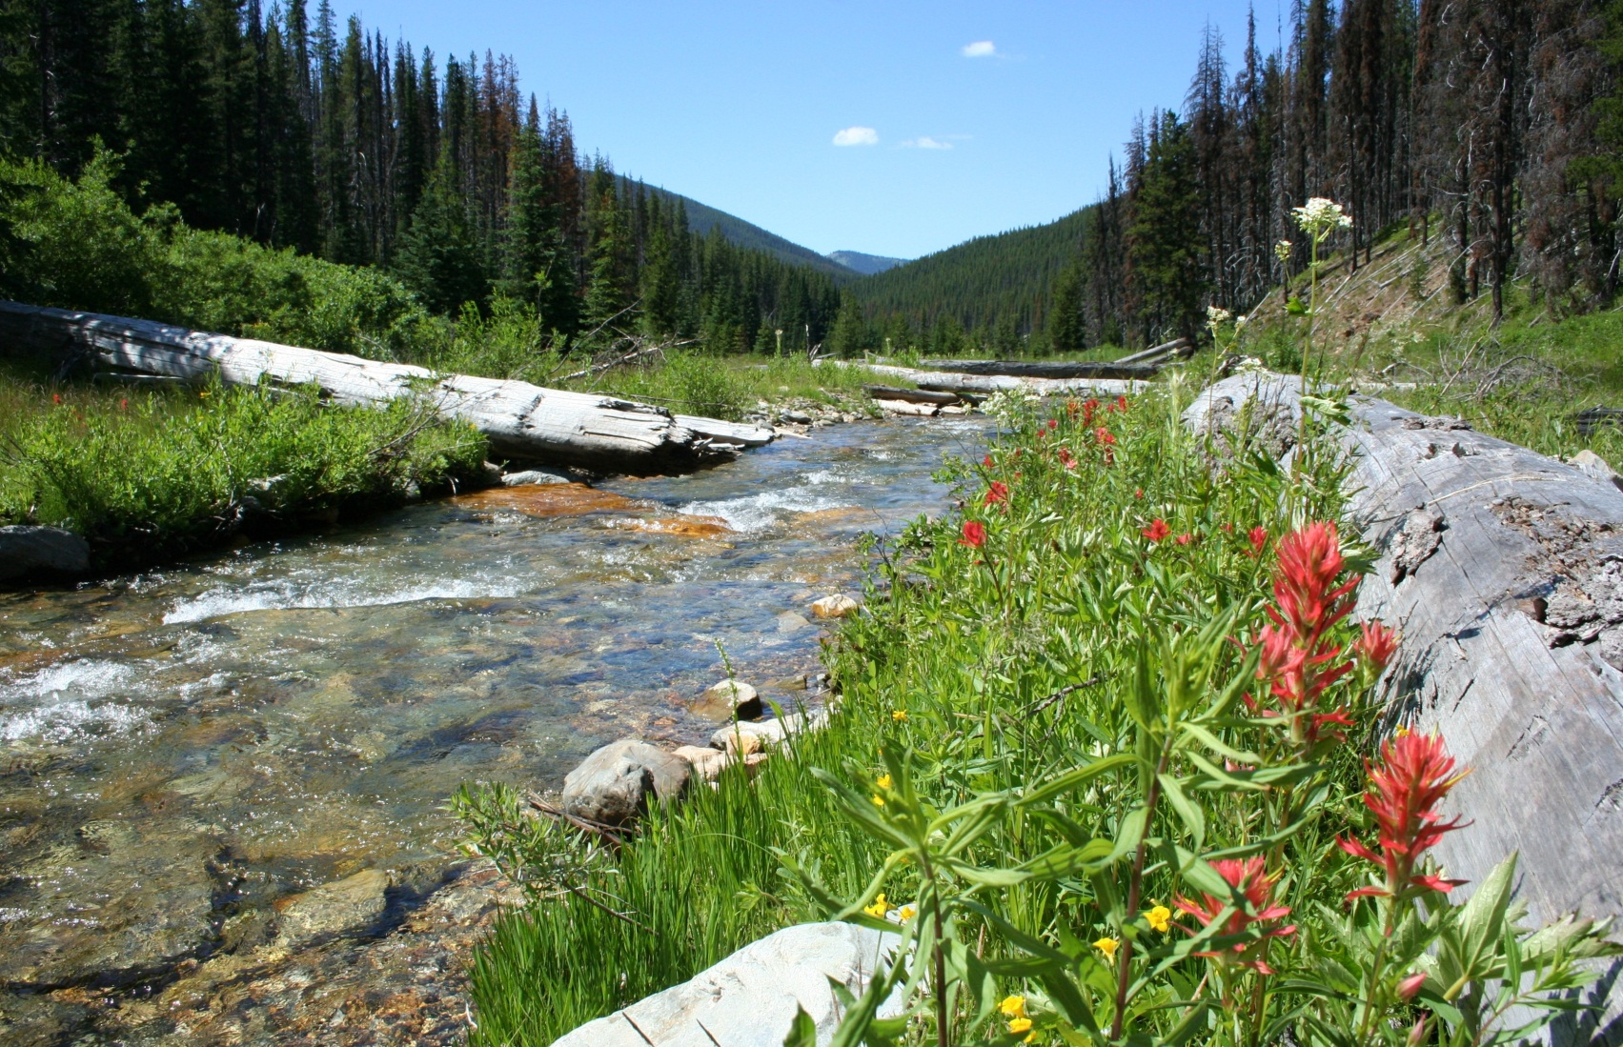
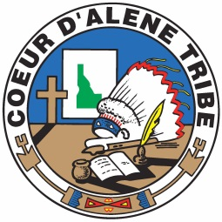
Questions?
Rebecca Stevens
Restoration Coordinator
Coeur d’Alene Tribe
rstevens@cdatribe-nsn.gov

