Slide 1
Idaho Power
Idaho Society of
Professional Engineers
June 22, 2012

Slide 2
Advanced Metering Infrastructure (AMI) – “Smart Meters”
Approximately 500,000 meters changed out to Smart Meters
Operational Efficiency
Quicker response to outages
Capable of recording daily usage

Slide 3
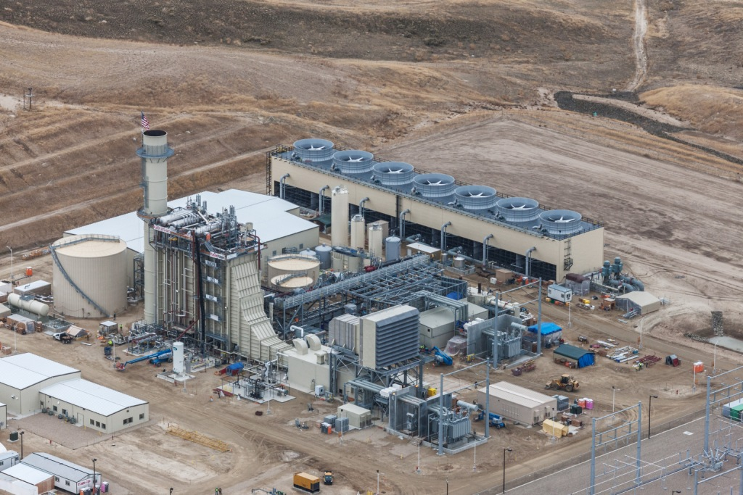
Langley Gulch Power Plant
The Langley Gulch Power Plant meets our customer needs.
300 megawatts of electricity
year-round
Integrates intermittent,
alternative wind & solar energy
Uses two turbines, one with
natural gas and the other steam
Clean, efficient and quiet

Slide 4
Transmission Projects
Gateway West
Wyoming to SW Idaho
Boardman to Hemingway
Boardman, Oregon to SW Idaho

Slide 5
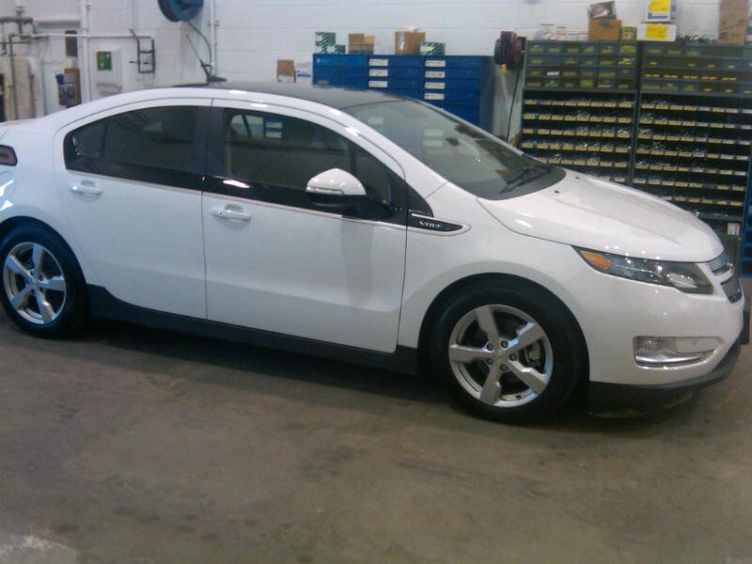
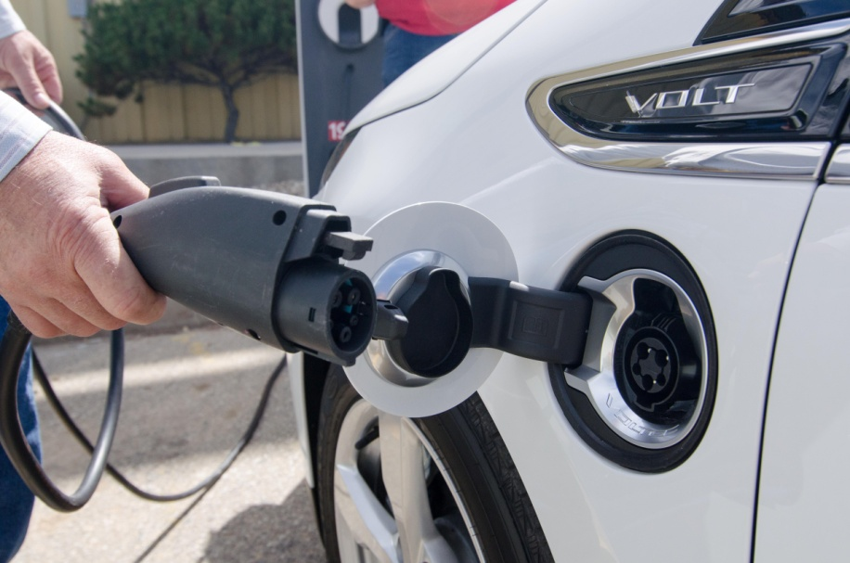
Electric Vehicles Pilot Program
Determine Benefits for Idaho Power Fleet
Evaluate Infrastructure Demands
Answer Customer Questions About EVs

Slide 6
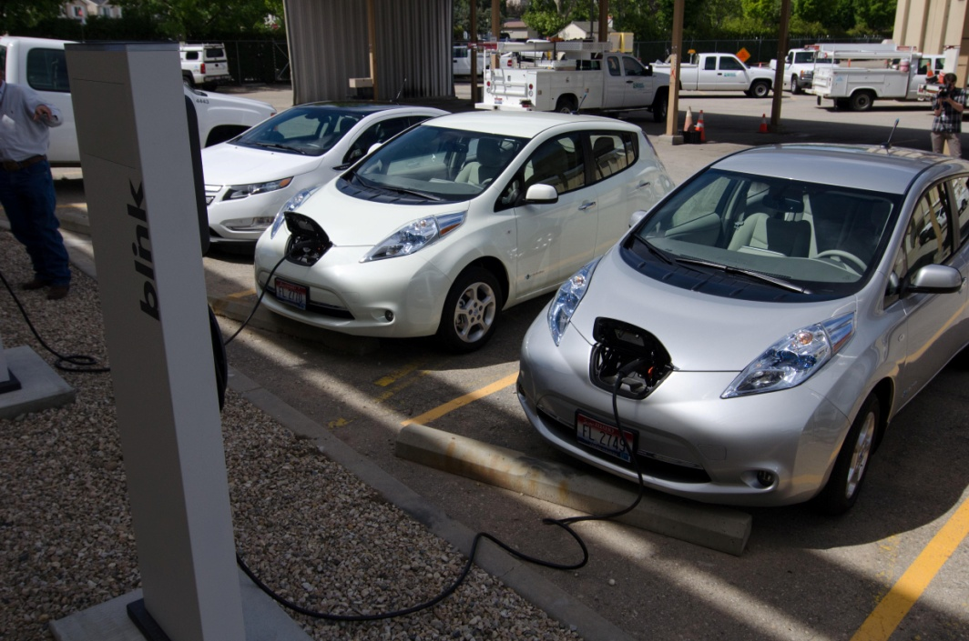
Electric Vehicles Pilot Program
Chevy Volt
Nissan Leaf

Slide 7
What is Idaho Power’s Stand
on Renewable Energy?

Slide 8
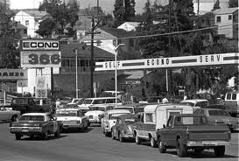
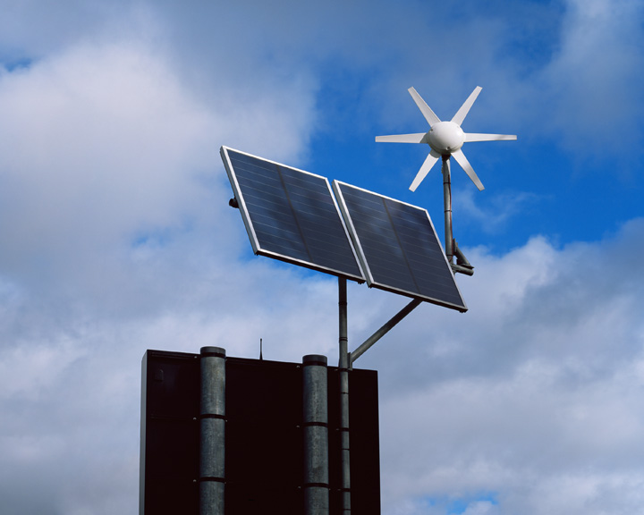
PURPA
Public Utility Regulatory Policies Act
What is PURPA?
Notes:
The Public Utility Regulatory Policies Act (PURPA) is a law passed in 1978 by the U.S. Congress and signed into law by President Jimmy Carter at the height of the global energy crisis. It was intended to promote greater use of domestic renewable energy.
PURPA requires utilities such as Idaho Power to buy electricity from renewable energy producers whether the electricity is needed or not.

Slide 9
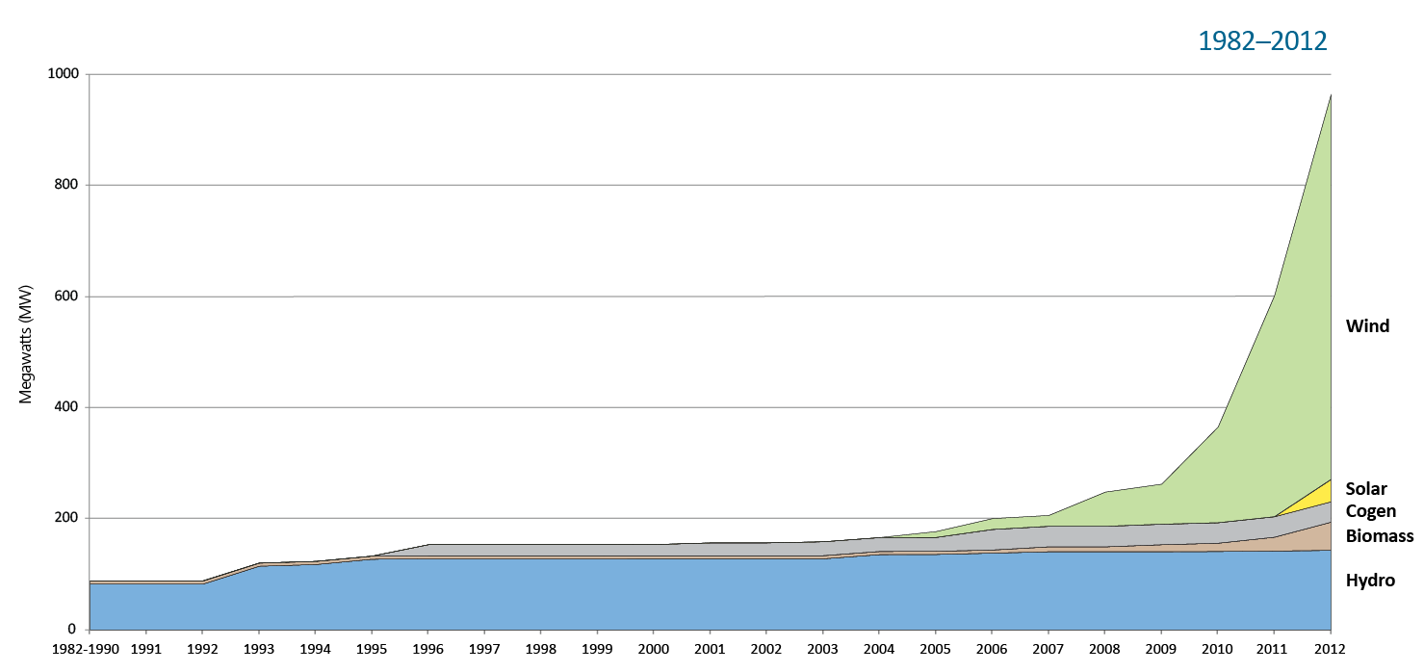
Why Is That A Problem?

Slide 10
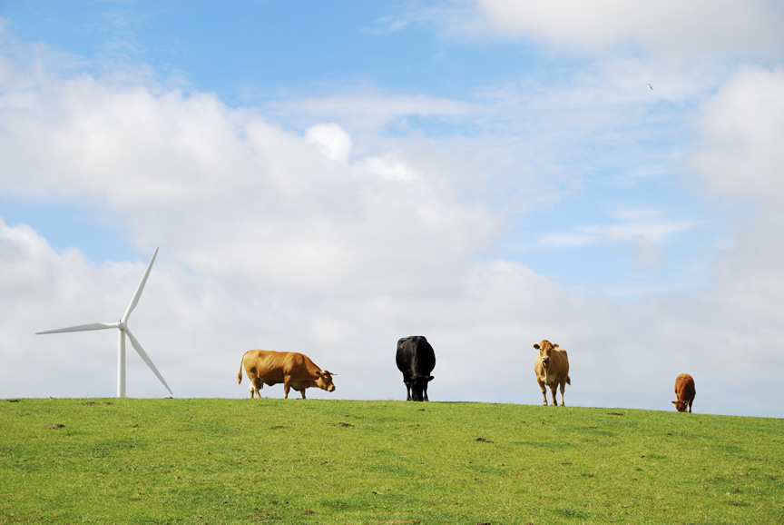
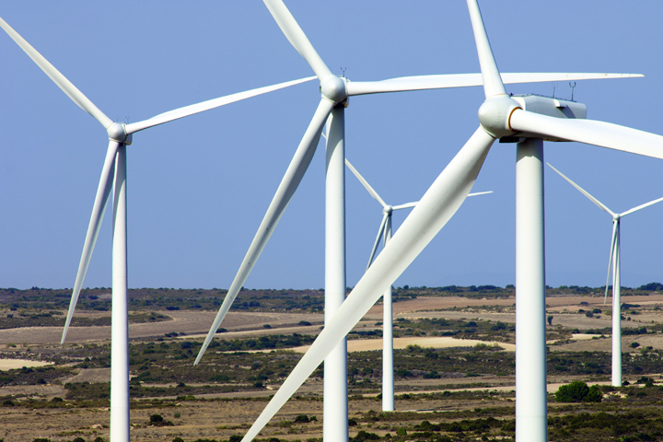
David and Goliath

Slide 11
The Real Story
System Load vs Total Wind
463 MW Peak for Wind Generation
12-30-2011 @ 23:26 MT
Megawatts (MW)
Peak Time

Slide 12
What Does That Mean?
$850 Million

Slide 13
What Are We Doing About It?
10 MW
Idaho Power believes the model used for setting prices is the fundamental issue driving these unnecessary costs for our customers.
100 kW

Slide 14
The Plan
Our Request:
Set prices based on VALUE
Clarify the negotiation process
Reduce contract terms to five years
Enable us to use the least-cost resource during periods of low demand

Slide 15
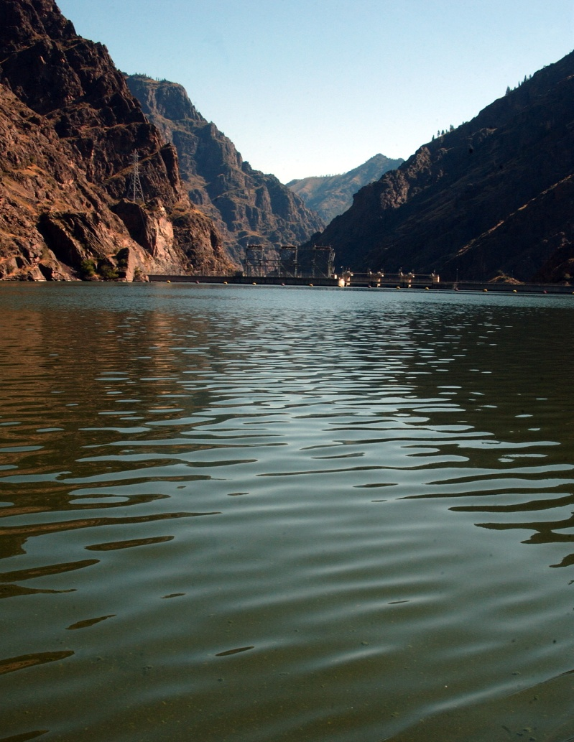
Take Away Points
Idaho Power is not against Renewable Energy
Our Mission is to provide reliable, responsible, fair priced energy services, today and tomorrow
PURPA Pricing is Driving Rates Up – Putting At Risk Our Low Energy Rates

Slide 16
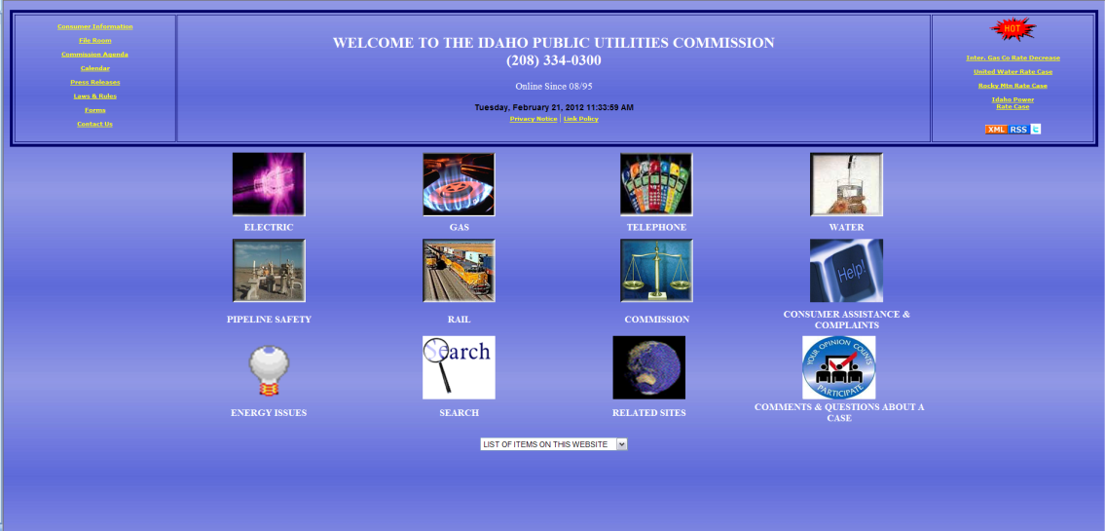
Take Away Points
We Need Your Support
Speak up
Participate in Public Comment Period
Visit: www.getpluggedin.com
Visit: www.puc.idaho.gov

Slide 17
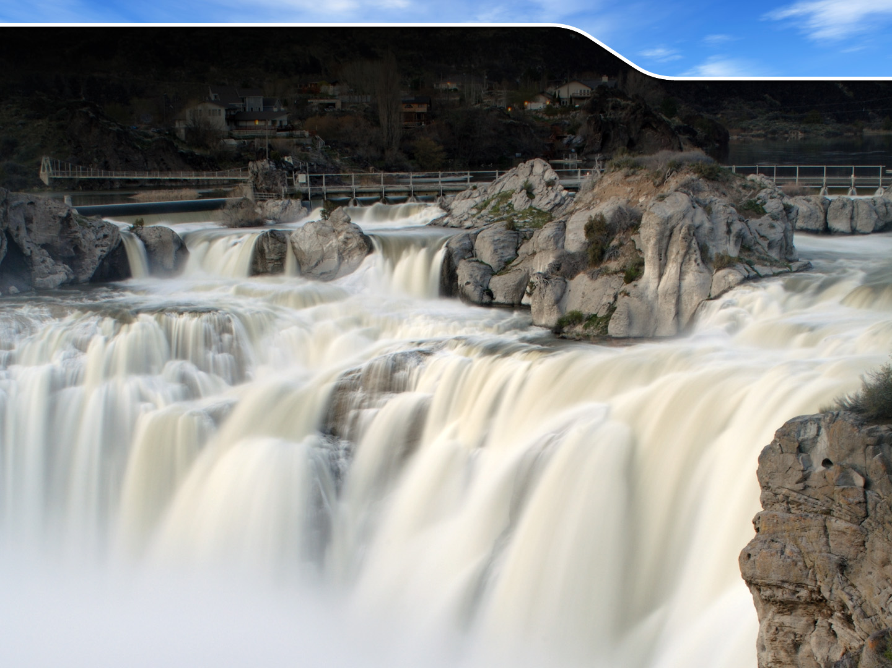
Thank You
Questions
Questions?

